Slide 1
FIRST 100 DAYS IN MILK
Cow nutrition, management and profit
Workshop for Dairy Advisers
1

Slide 2

Session 1.
Welcome and introduction
2

Slide 3
WORKSHOP AIMS:
You are equipped with the latest knowledge on key aspects of cow nutrition, management and profit in the first 100 DIM, and
You are better able to help farmers develop and implement strategies to improve their cows’ nutrition, management and profit in the first 100 DIM
3

Slide 4
PROGRAM
Session 1 | Welcome and introduction
Session 2 | PRE-CALVING TRANSITION PERIOD – Further aspects
 | Morning tea (11:00-11:20am)
Session 3 | FRESH PERIOD - Nutritional programming of cows
 | Lunch (12:45-1:15pm)
Session 4 | EARLY LACTATION - Optimising cow productivity and profit
 | Afternoon tea (2:45-3:00pm)
Session 5 | Helping farmers develop and implement strategies to improve cows’ nutrition, management and profit in the first 100 DIM
Session 6 | Summary / Where to from here

Slide 5

RULES OF ENGAGEMENT
What does it mean to be respectful to other participants and the facilitator?
Confidentiality (Chatham House rule applies)
Punctuality
Mobile phones off or on silent
Respect for other people’s views / opinions (No questions are stupid)
Contributing to discussion and activities
Giving positive feedback to other participants
5

Slide 6

INTRODUCTIONS
Hi, I am …………………...............
I am from ………………………….
My on-farm advisory role is ……………………………
One thing I would like to get from participating in this workshop is ……………………………
6

Slide 7
Session 2.
PRE-CALVING TRANSITION PERIOD – Further aspects
PRE-CALVING TRANSITION PERIOD
FRESH
PERIOD
EARLY LACTATION
7

Slide 8
Session 2: pre-calving TRANSITION PERIOD
In this session you will:
Recall key points on management of the transition cow pre-calving from the DA Transition Cow Management (TCM) Adviser Workshop, and
Learn about 3 further aspects of pre-calving TCM:
    Low feed intake pre-calving
    Cow’s protein pool and muscle mobilization
    Impacts of heat stress in late gestation on cow and next generations.

Slide 9
ACTIVITY (4 bus stops)
pre-calving TRANSITION PERIOD
YOU ARE SETTING UP A PRE-CALVING TRANSITION PROGRAM ON A FARM
Go to each of the 4 stations in the room and write down things that you need to consider and get right concerning:
Animals
Feed
Facilities
People
These may be things you need to set up and manage, choices to be made, information collected, decisions and actions taken.

Slide 10
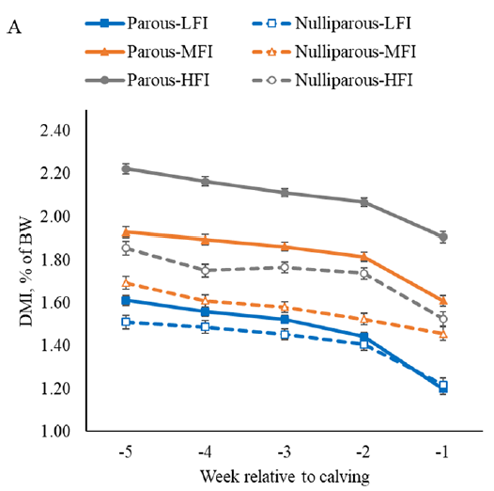
1. Feed intake pre-calving
Cows normally experience reduced feed intake in the last few weeks of pregnancy.
(Santos et al., 2024)

Slide 11
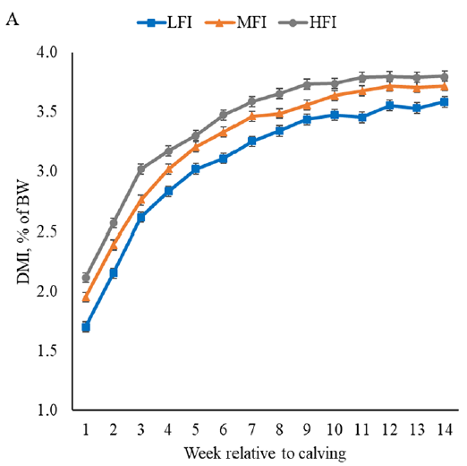
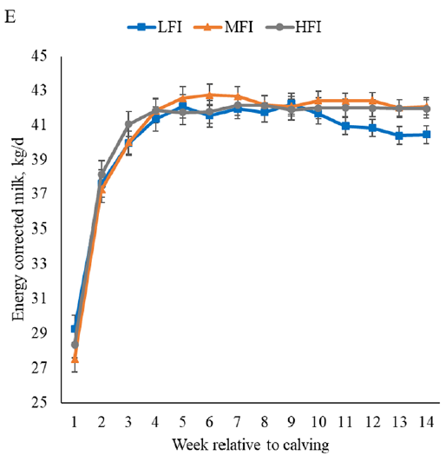
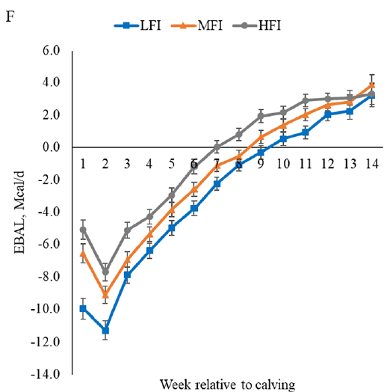
1. Feed intake pre-calving
a)
b)
Cows normally experience reduced feed intake in the last few weeks of pregnancy.
Many studies have shown that very low feed intake pre-calving is associated with the following post-calving:
Impaired immune function
Increased risk of health problems including: metritis, mastitis, ketosis, displaced abomasum.
Reduced feed intake, more severe negative energy balance (NEB).
c)
a) Dry matter intake (DMI) as % of body weight
b) Energy corrected milk yield
c) Energy balance
in lactating cows classified according to averaged DMI as % of BW in the last 5 weeks of pregnancy, as:
Low feed intake (LFI)
Moderate feed intake (MFI)
High feed intake (HFI) (Santos et al., 2024).

Slide 12
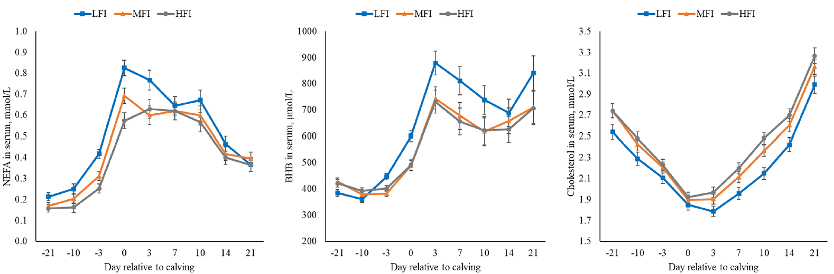
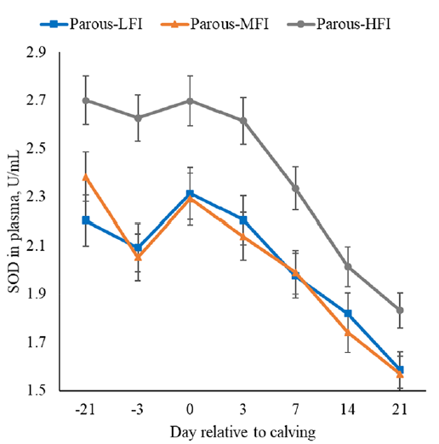
1. Feed intake pre-calving
More reduced feed intake pre-calving is also associated with the following post-calving:
Higher blood NEFA and BHB concentrations
Lower blood superoxide dismutase (SOD) activity
a)
b)
c)
a) Non-esterified fatty acid (NEFA) concentration in blood
b) β-hydroxybutyrate (BHB) concentration in blood
c) Superoxide dismutase (SOD) in blood
of transition cows classified according to averaged DMI as % of BW in the last 5 weeks of pregnancy, as:
Low feed intake (LFI)
Moderate feed intake (MFI)
High feed intake (HFI) (Santos et al., 2024).

Slide 13
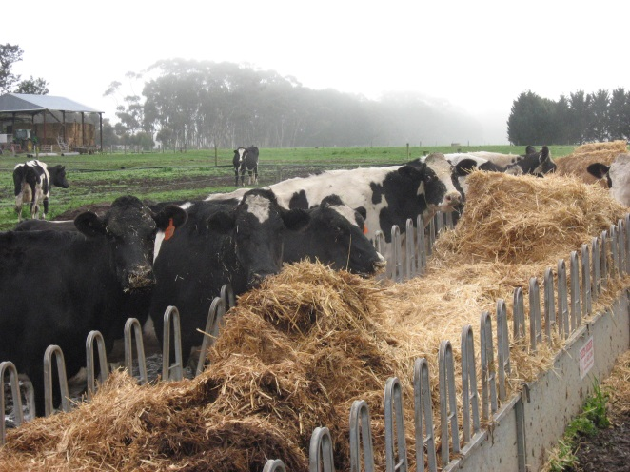
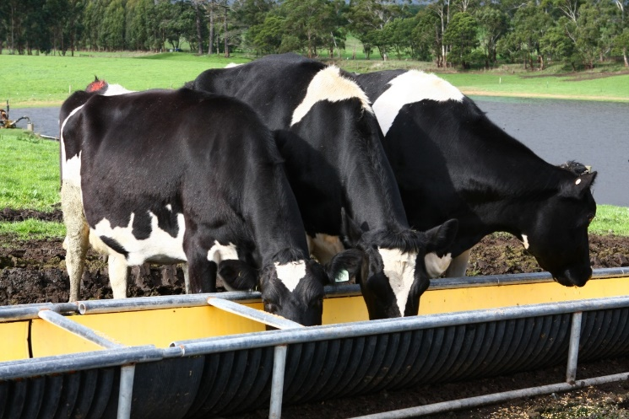
1. Feed intake pre-calving
ACTIVITY (in groups of 3):
On butcher’s paper, create 2 columns headed:
FACTORS contributing to low feed intake pre-calving
STRATEGIES to sustain high feed intake pre-calving
Write as many points in each column as you can.
Notes:
Factors include:
Animal factors:
Parity
Pre-calving bodyweight and BCS (Leptin produced by fat cells suppresses feed intake via neural signal)
Feed factors:
NDF level of diet
Fat level of diet

Slide 14

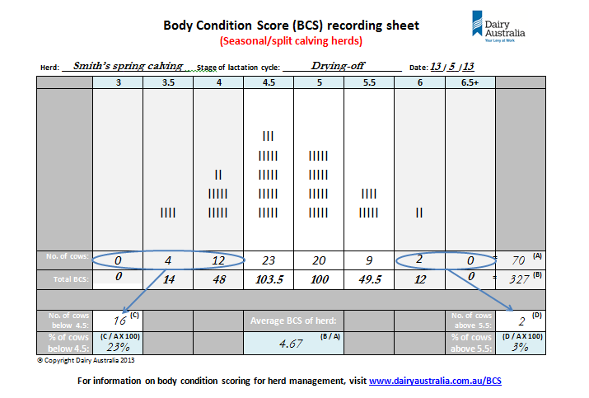
2. COW’S PROTEIN POOL AND MuScle mobilisation
🤔
When body condition scoring, what are we assessing?
Notes:
In this study by Hanno et al, 2024:
Cows depleted over 30% of skeletal muscle reserves present at calving within the first 60 days of lactation and substantial restoration of these reserves did not occur until late lactation.
This depletion and accretion pattern differed from that of subcutaneous fat, which was depleted from calving through early lactation but began to increase after nadir was reached at 90 DIM.

Slide 15
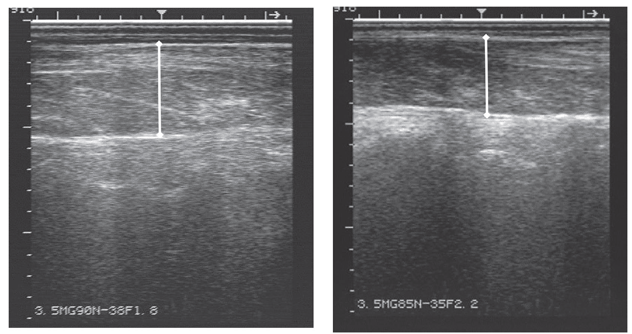
2. COW’S PROTEIN POOL AND MuScle mobilisation
A cow’s protein pool = 12-13% of empty BW (approx. 70-100kg).
Cows can mobilise 25-30% of their total body protein (muscle).
Ultrasonic measurement of longissimus dorsi muscle depth and back fat depth has been described as an accurate method to evaluate body tissue mobilisation around calving.
4.33cm
3.63cm
Body condition loss =
mobilization of fat AND muscle tissues.
Ultrasound images of longissimus dorsi muscle of two cows of differing muscle depth (McCabe and Boerman, 2020).
Notes:
In this study by Hanno et al, 2024:
Cows depleted over 30% of skeletal muscle reserves present at calving within the first 60 days of lactation and substantial restoration of these reserves did not occur until late lactation.
This depletion and accretion pattern differed from that of subcutaneous fat, which was depleted from calving through early lactation but began to increase after nadir was reached at 90 DIM.

Slide 16
2. COW’S PROTEIN POOL AND MuScle mobilisation
During pre-calving transition period, demand for Essential Amino Acids (EAA) is increased to support:
Growth of foetus and gravid uterus
Mammary gland secretory cell development
Colostrum production.
So cows may enter negative protein balance (NEB), and begin mobilising muscle tissue. This can be exacerbated by diet composition and the reduction in DMI pre-calving.
Studies have shown that supplying higher Metabolisable Protein inputs per day in diet of pre-calving transition cows has limited benefits (Westhoff et al., 2024).
Body condition loss =
mobilization of fat AND muscle tissues.
Notes:
In this study by Hanno et al, 2024:
Cows depleted over 30% of skeletal muscle reserves present at calving within the first 60 days of lactation and substantial restoration of these reserves did not occur until late lactation.
This depletion and accretion pattern differed from that of subcutaneous fat, which was depleted from calving through early lactation but began to increase after nadir was reached at 90 DIM.

Slide 17
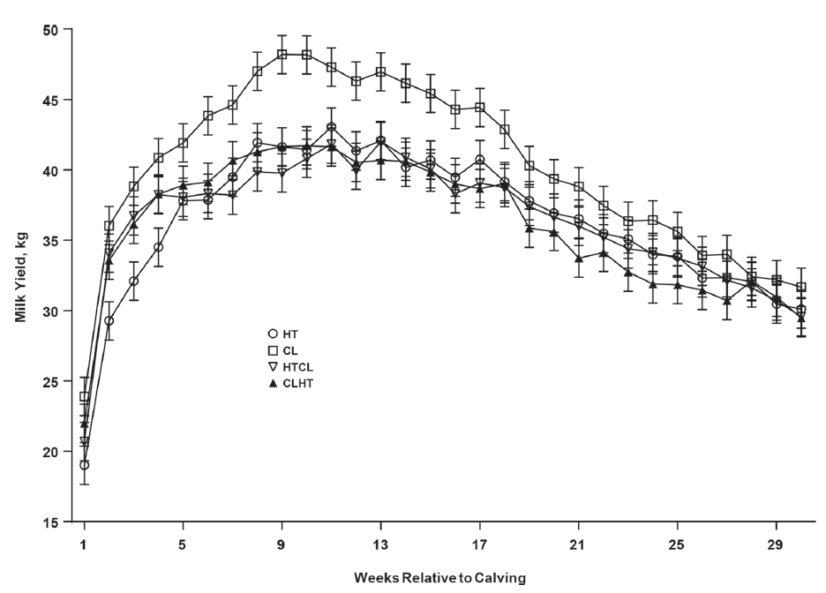

3. Impacts of heat stress IN late gestation
On cows in their subsequent lactation
1. Reduced lactation performance
Effect of cooling (CL; n = 19), heat stress (HT; n = 18), and combinations (CLHT; n = 16; HTCL; n = 20) during a 45-day dry period on milk yield up to 30 weeks post-calving. After calving, all cows were managed and housed under the same conditions (Fabris et al., 2019).

Slide 18
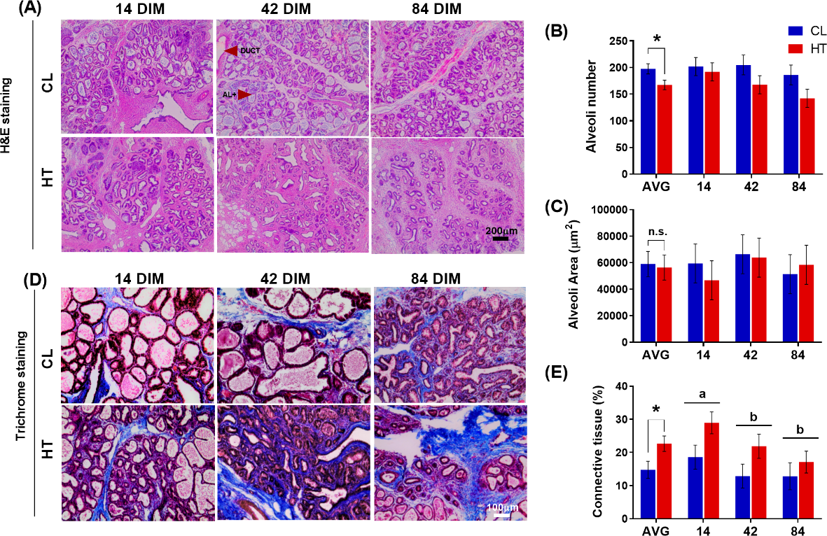
3. Impacts of heat stress IN late gestation
On cows in their subsequent lactation
1. Reduced lactation performance
Due to:
Impaired mammary gland involution and remodelling
Reduced nutrient supply to mammary gland due to reduced feed intake
Mammary tissue of multiparous Holstein cows heat stressed (HT, access to shade only, n = 6) or cooled (CL, access to shade, fans, and water soakers, n = 6) during a 46-day dry period. Mammary biopsies were collected at 14, 42, and 84 days in milk (DIM) (Dado-Senn et al., 2019).

Slide 19
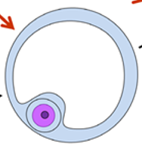
3. Impacts of heat stress IN late gestation
On cows in their subsequent lactation
2. Reduced reproductive performance
Thompson and Dahl (2012) found that cows heat stressed in the dry period had more days from calving to first oestrus and more days open in the subsequent lactation.
Stevenson et al. (2022) found that the conception rate of cows heat stressed in late gestation was 6.7% lower than that of cooled cows (39.0% vs. 45.7%) .
Rodriguez-Godina et al. (2024) found that the conception rate of cows heat stressed in late gestation was 17.6% lower than that of cooled cows (42.6% vs. 60.2%).
Prospective, cohort studies by Collier et al., 1982; Lewis et al., 1984; Avendano-Reyes et al., 2006; Adin et al., 2009; Karimi et al., 2015 and Scanavez et al., 2019 reported higher reproductive performance in cows that were cooled in late gestation rather than heat stressed. However, the differences were not statistically significant, but these studies had small sample sizes.
Lewis and co-workers (1984) examined the ovaries of cows in their study and found that those provided with shade in late gestation:
had larger ovaries with greater diameter of the largest follicle and corpus luteum, and
were more likely to have a corpus luteum compared to cows not provided with shade..

Slide 20
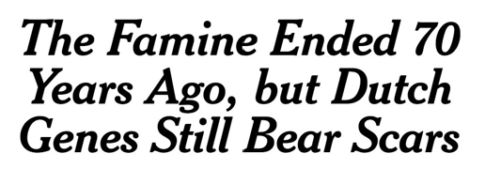

3. Impacts of heat stress IN late gestation
On next generations’ lifetime performance through developmental programming
Heat-stress in-utero induces changes in gene activity and function without any changes in DNA sequence.
Generation |  | Means of exposure to heat stress
Dam | F₀ | Directly exposed to heat stress during pregnancy of F₁
Daughter | F₁ | Exposed to heat stress in-utero. Epigenetic reprogramming of oocytes that will give F₂ generation
Grand-daughter | F₂ | Not exposed to heat stress, but the product of the heat stress exposed, epigenetic modified F₁ oocytes which are fertilised
Grand grand-daughter | F₃ | Not exposed to heat stress, but may inherit epigenetic modified F₁ oocytes by transgenerational transamination via F₂

Slide 21
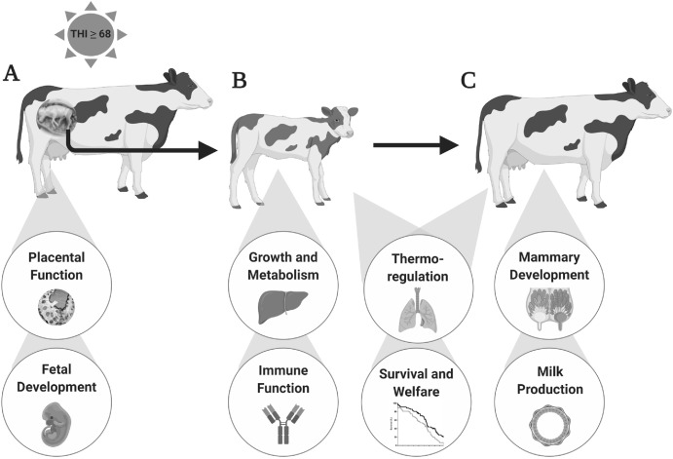
3. Impacts of heat stress IN late gestation
On next generations’ lifetime performance through developmental programming
a)
b)
c)
Impact of in-utero heat stress on offspring outcomes as:
developing foetus,
postnatal calf, and
mature cow
(Dado-Senn et al., 2020).

Slide 22
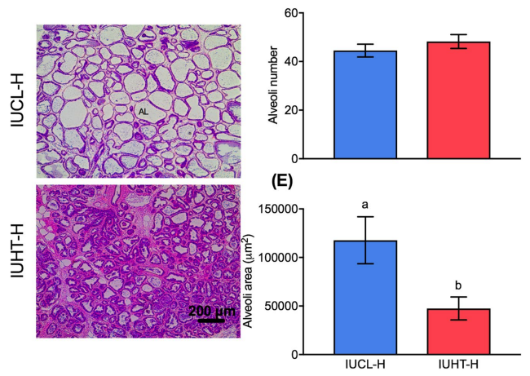
3. Impacts of heat stress IN late gestation
On next generations’ lifetime performance through developmental programming
Histological evaluation of mammary tissue collected from in-utero heat-stressed (IUHT-H) and in-utero cooled (IUCL-H) heifers at 21 days into their first lactation (Skibiel et al., 2018).

Slide 23
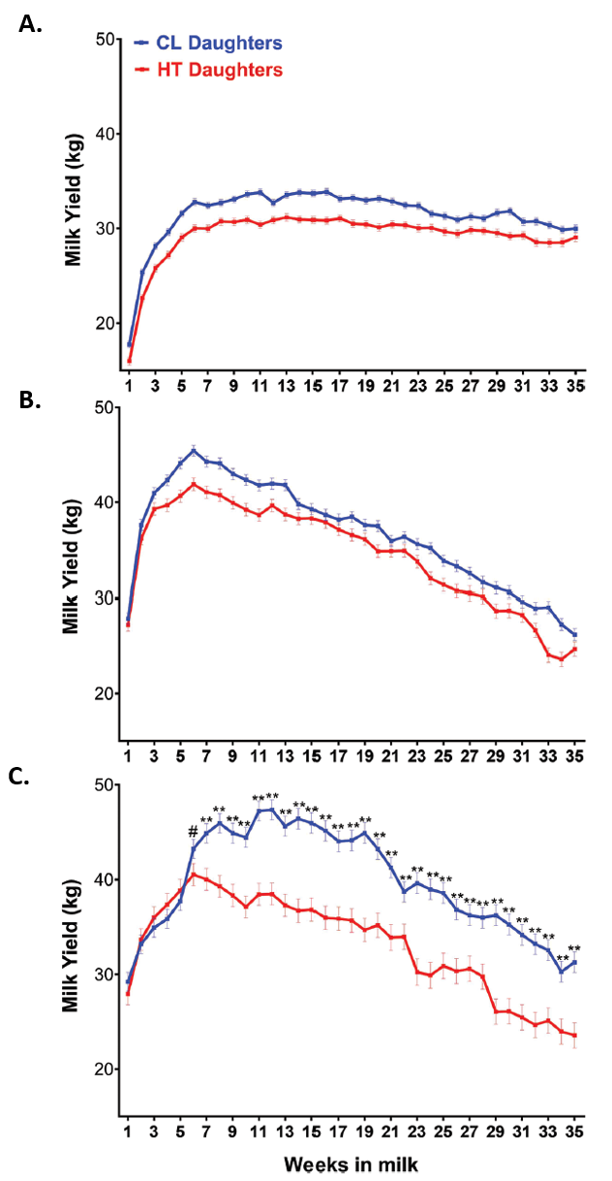

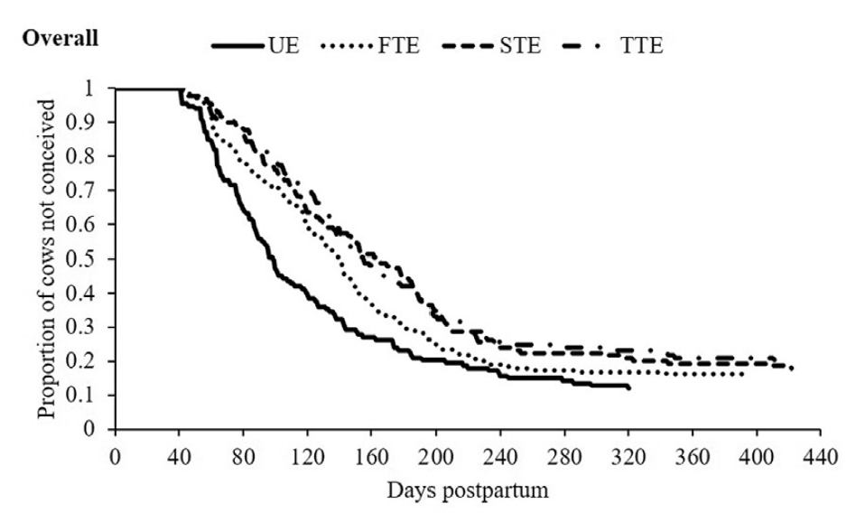
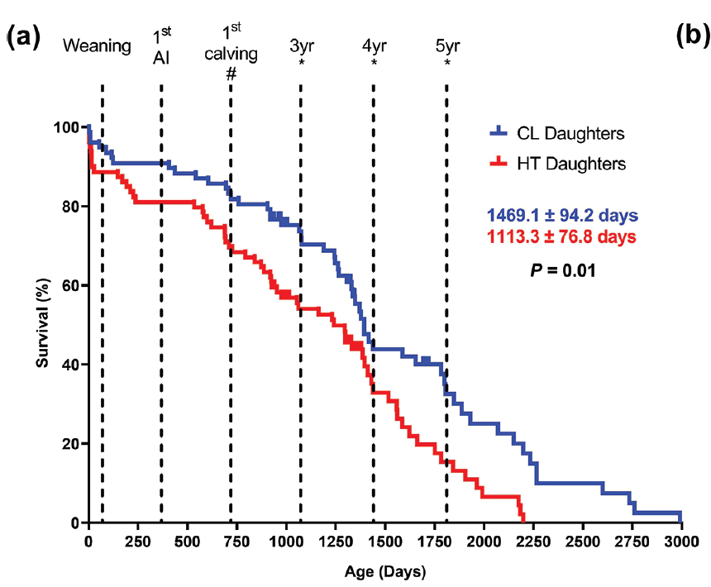
3. Impacts of heat stress IN late gestation
On next generations’ lifetime performance through developmental programming
a)
Milk yields of daughters (F1s) born to cows under cooling (CL; access to fans, shade, and water soakers) or heat stress (HT; only access to shade) during late gestation (~46 days) in:
first lactation
second lactation,
third lactation.
All daughters had access to active cooling (shade of a freestall barn, fans, and water soakers) during their first, second, and third lactations (Laporta et al., 2020)
b)
Time to conception in daughters (F1s) exposed to heat stress in-utero during their first, second, third and fourth lactations, and overall, considering heat stress exposure during different trimesters of gestation.
UN = unexposed
FTE = first trimester exposed
STE = second trimester exposed
TTE = third trimester exposed (Akbarinejad et al., 2017).
Survival of daughters (F1s) born to cows under cooling (CL; access to fans, shade, and water soakers) or heat stress (HT; only access to shade) during late gestation (~46 days) (Laporta et al., 2020).
c)

Slide 24
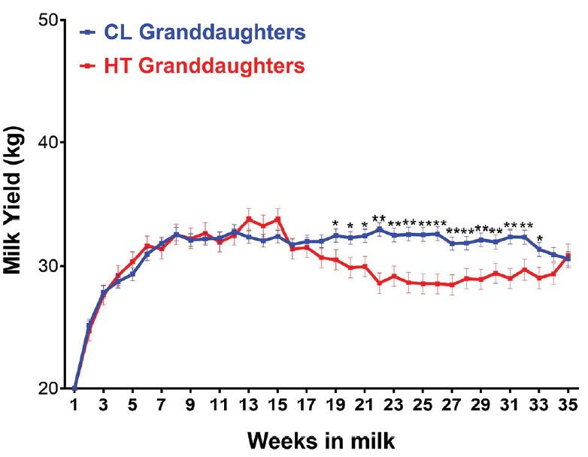
3. Impacts of heat stress IN late gestation
On grand-daughters and great-granddaughters’ lifetime performance through developmental programming
Milk yield in the first lactation of grand-daughters (n = 23) of cows that were exposed to cooling (CL; access to fans, shade, and water soakers; n = 16) or heat stress (HT; only access to shade; n = 7) while pregnant (~last 46 days) with their mothers. Thus, the mothers experienced heat stress or cooling through the intra-uterine environment the last 46 days of gestation. Data from grand-daughters born from 10 different experiments were analyzed. All grand-daughters had access to active cooling (e.g., shade of a freestall barn, fans, and water soakers) during their first, second, and third lactations. The HT grand-daughters produced less milk post-calving in the first lactation compared with CL granddaughters.
** indicates P < 0.01 and * indicates P < 0.05. (Laporta et al., 2020)
Inter-generational effects of maternal heat stress in late gestation may extend to great-granddaughters (F₃) through trans-generational epigenetic inheritance (Weller et al., 2021 and Macciotta et al., 2023).

Slide 25
Session 3.
FRESH PERIOD – Nutritional programming of cows
PRE-CALVING TRANSITION PERIOD
FRESH
PERIOD
EARLY LACTATION
25

Slide 26
SESSION 3: FRESH PERIOD
In this session you will:
Look at energy balance post-calving and its impacts,
Learn more about feed intake regulation in the Fresh Period and how Fresh Period feeding strategies can have carryover benefits,
Consider why increasing MP and AA supply may be more important for fresh cows than increasing energy supply, and
Learn more about fat supplementation, calcium balance, the impacts of heat stress on fertility, and stressors that contribute to systemic inflammation post-calving.

Slide 27
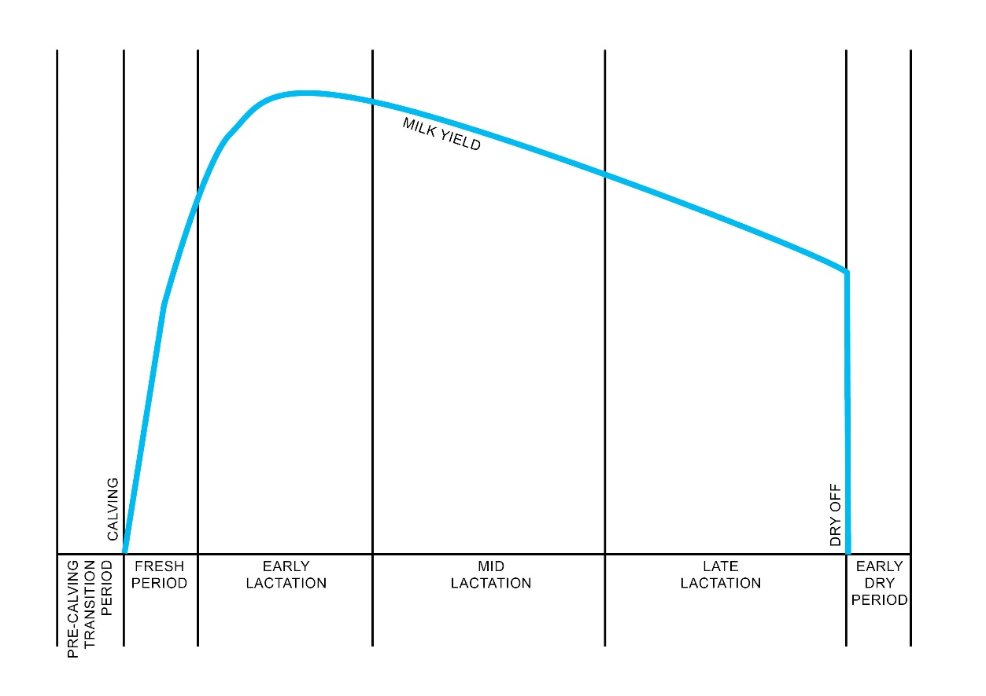
ACTIVITY (in groups of 3):
On Worksheet 1, draw lines for:
FEED INTAKE
BODYWEIGHT.

Slide 28
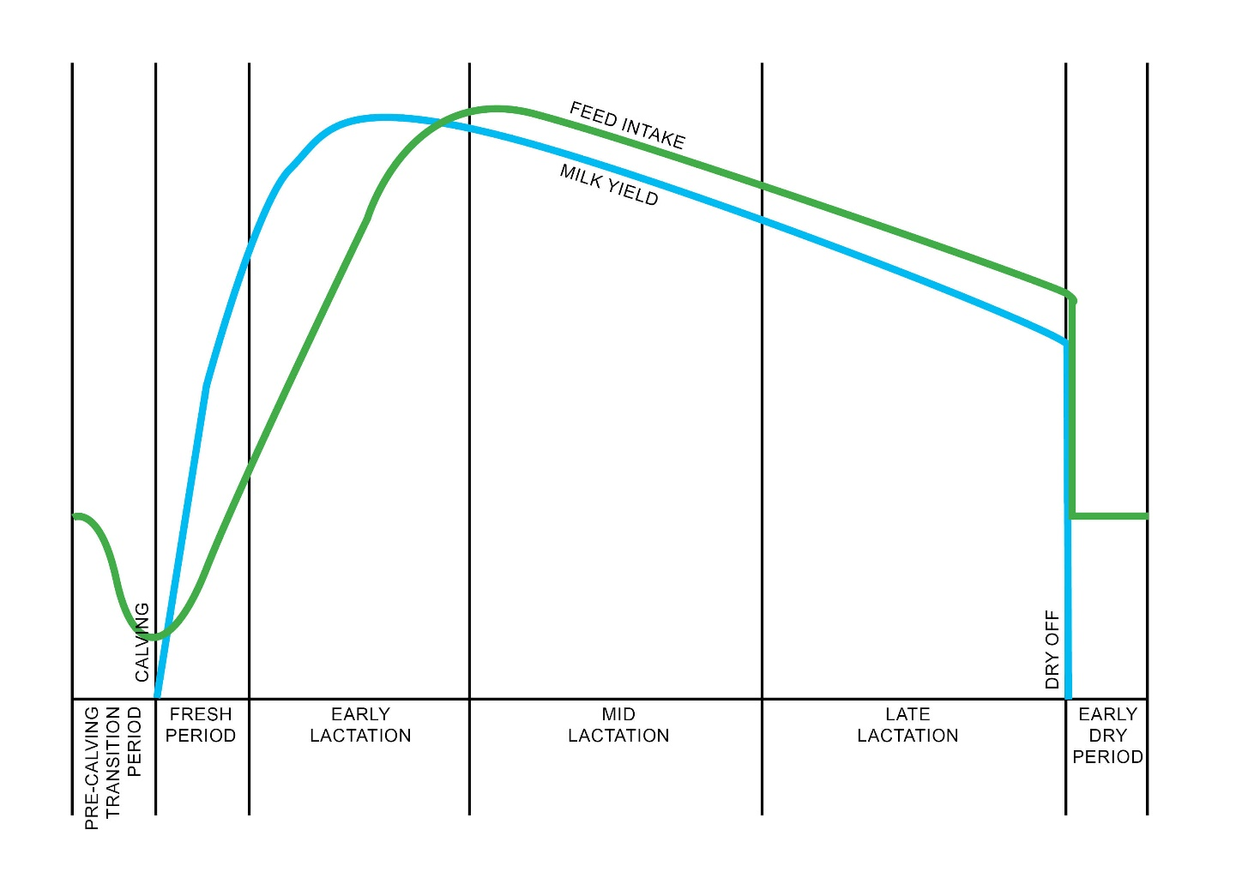
NEGATIVE Energy balance - IMPACTs

Slide 29
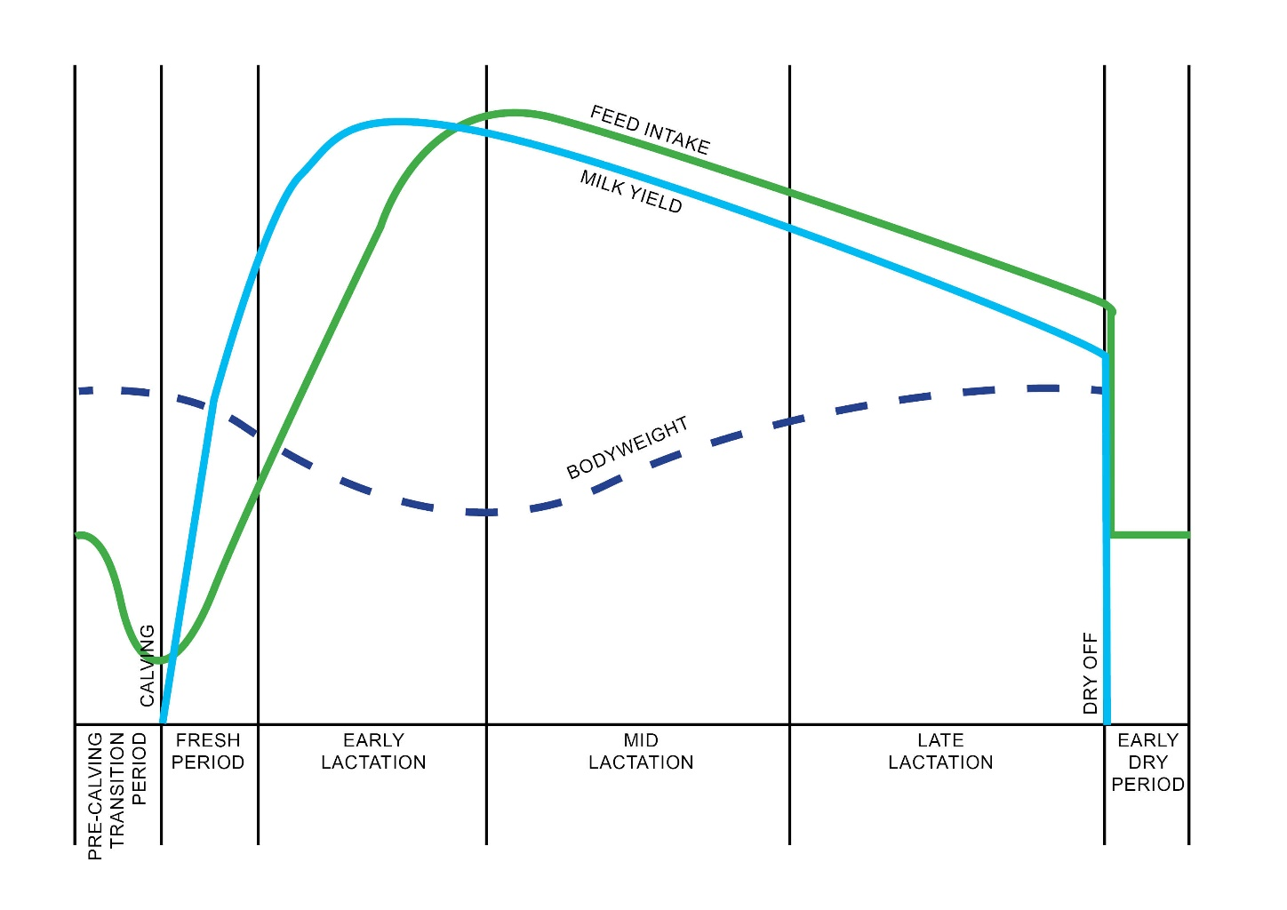
NEGATIVE Energy balance - IMPACTs

Slide 30
NEGATIVE Energy balance - IMPACTs

Slide 31
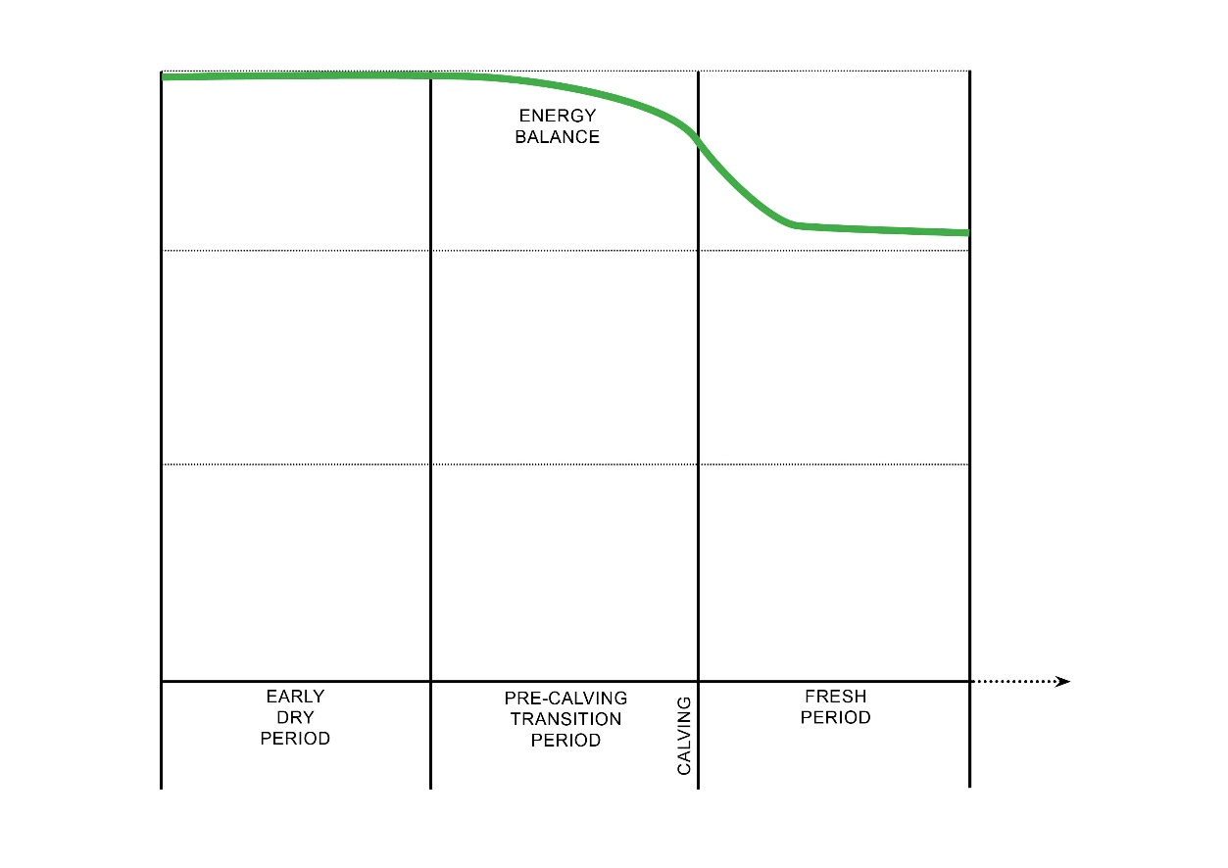
ACTIVITY (in groups of 3):
In the middle section of Worksheet 2, draw lines for:
NEFA / BHB
INSULIN
CALCIUM.

Slide 32
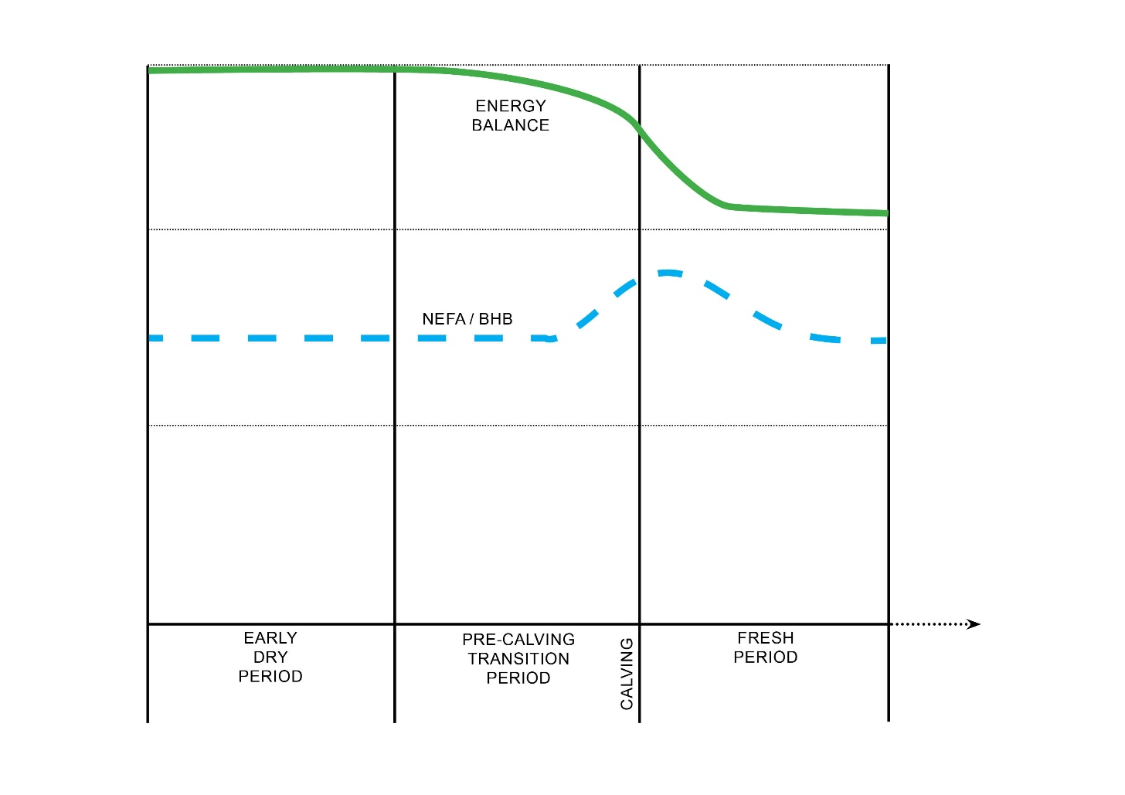
NEGATIVE Energy balance - IMPACTs

Slide 33
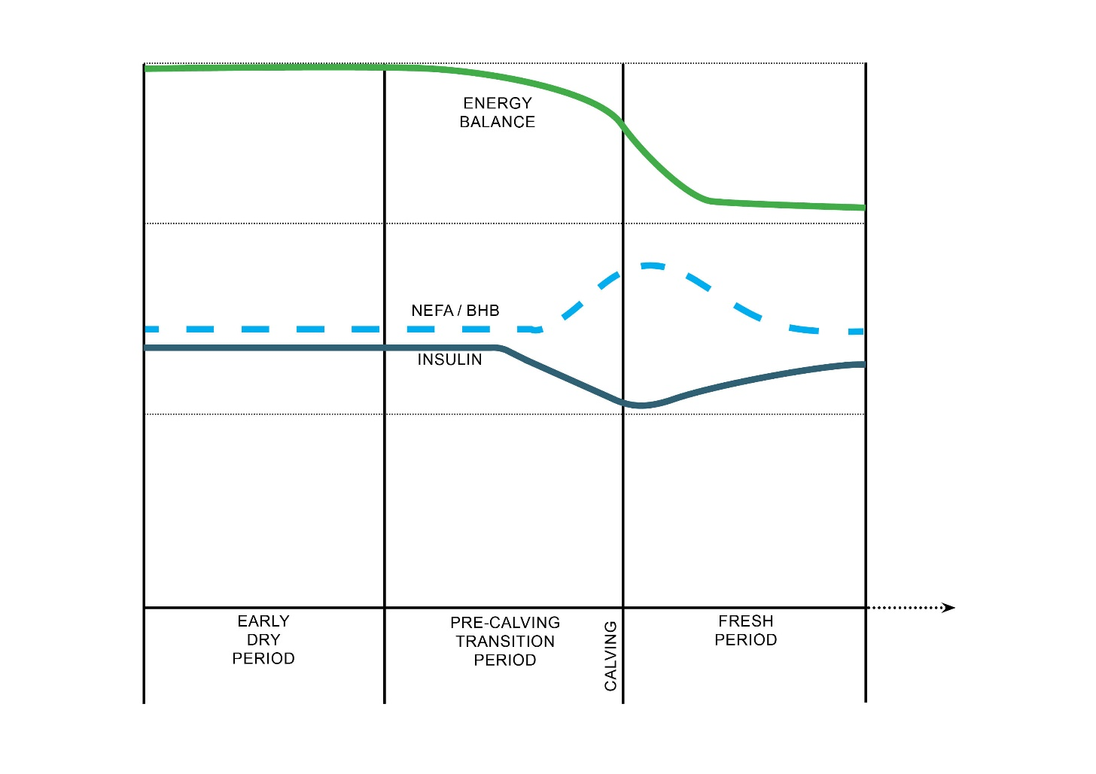
NEGATIVE Energy balance - IMPACTs

Slide 34
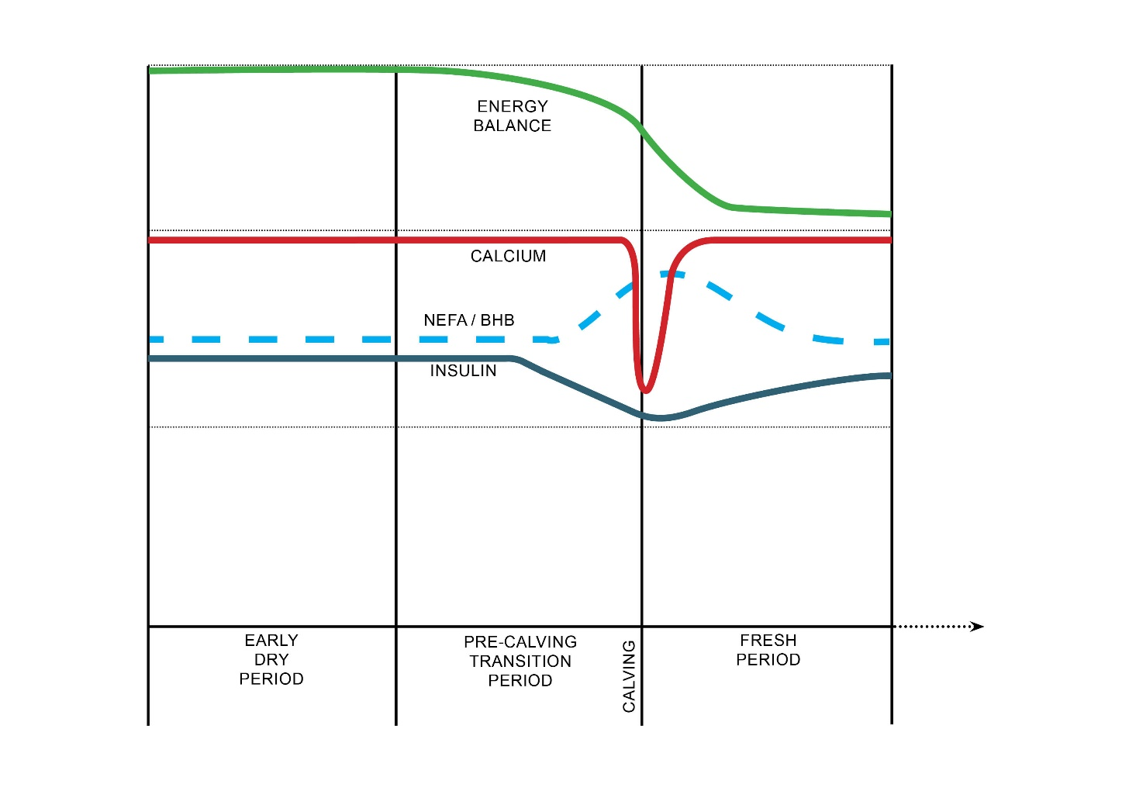
NEGATIVE Energy balance - IMPACTs

Slide 35
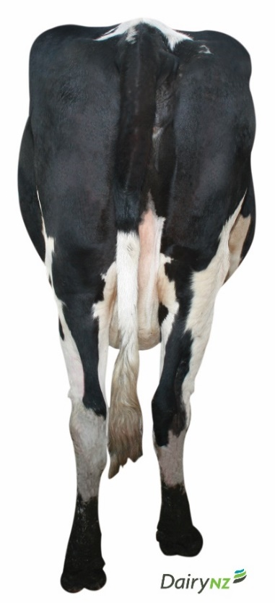
NEGATIVE Energy balance – IMPACTS
ACTIVITY (4 bus stops):
Go to each of the 2 stations on your side of the room and write down:
IMPACTS OF NEB POST-CALVING
FACTORS CONTRIBUTING TO SEVERITY OF NEB.

Slide 36
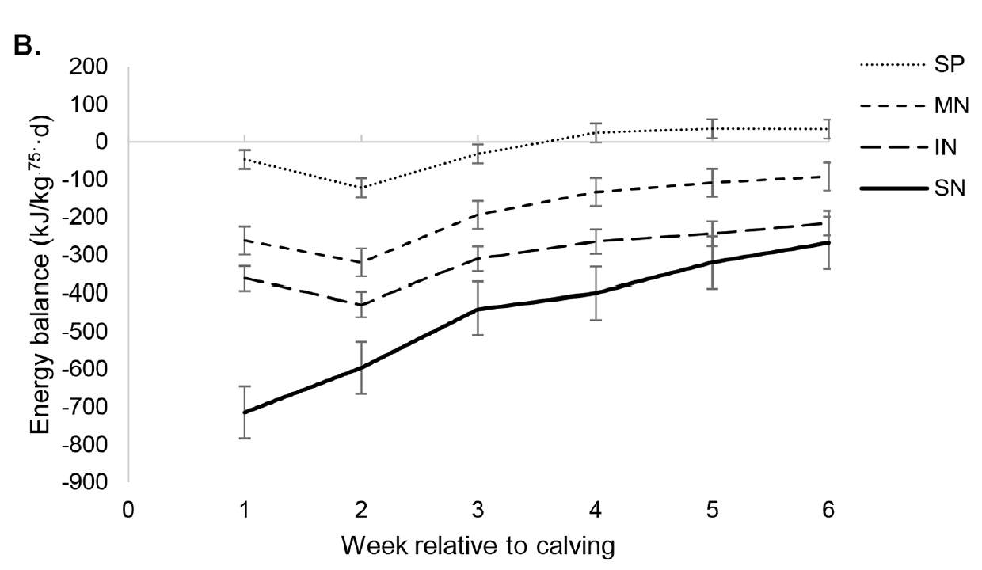
NEGATIVE Energy balance - IMPACTs
4 clusters of cows based on their energy balance time profiles in first 6 weeks after calving:
SP = stable profile
MN = mild negative EB
IN = intermediate negative EB
SN = severe negative EB
(Ma et al., 2024).

Slide 37
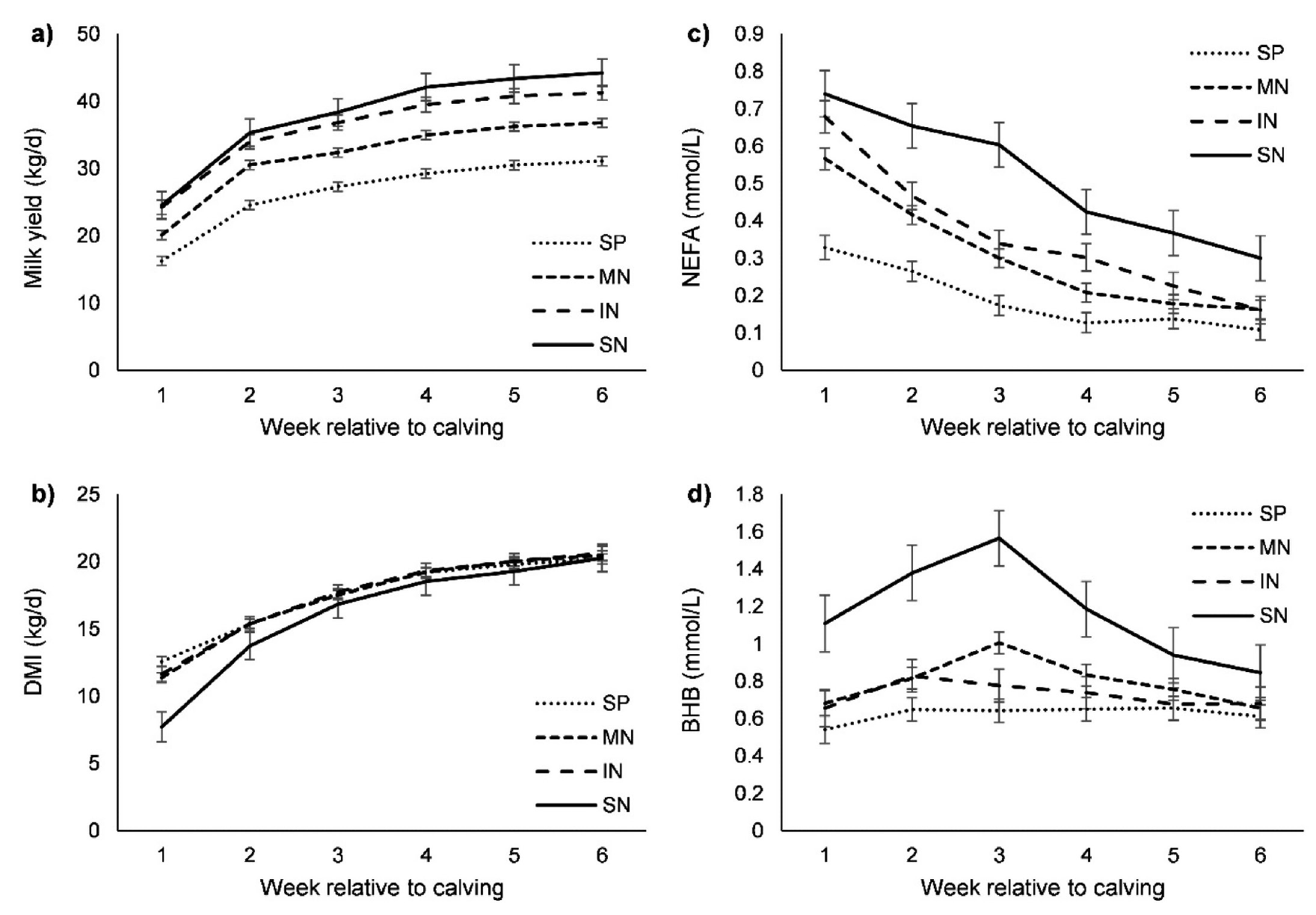
NEGATIVE Energy balance - IMPACTs
Milk yield
Dry matter intake
Non-esterified fatty acid (NEFA) conc’n in blood
β-hydroxybutyric acid (BHB) conc’n in blood
of 4 clusters of cows based on their energy balance time profiles in first 6 weeks after calving:
SP = stable profile
MN = mild negative EB
IN = intermediate negative EB
SN = severe negative EB
(Ma et al., 2024).

Slide 38
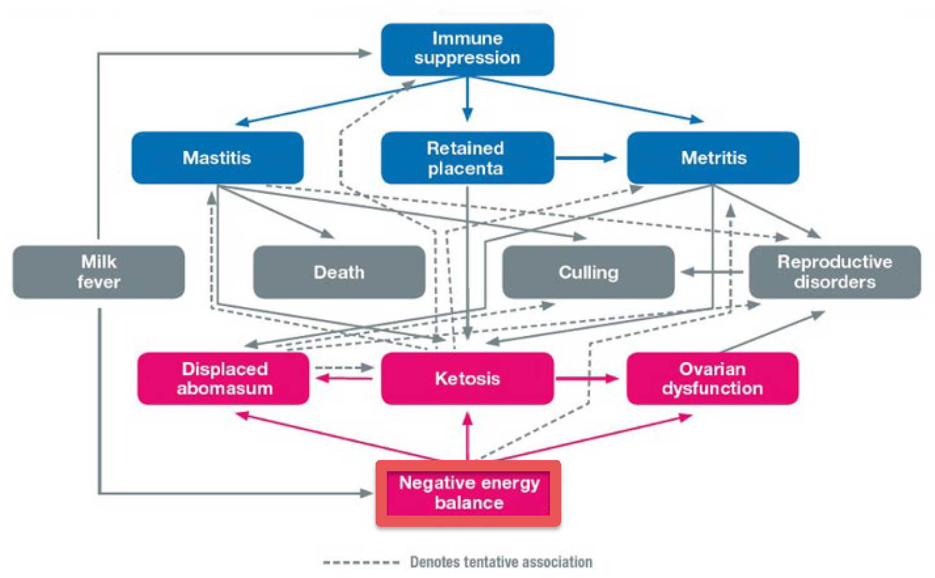
NEGATIVE Energy balance - IMPACTs
(Albornoz, 2020)

Slide 39
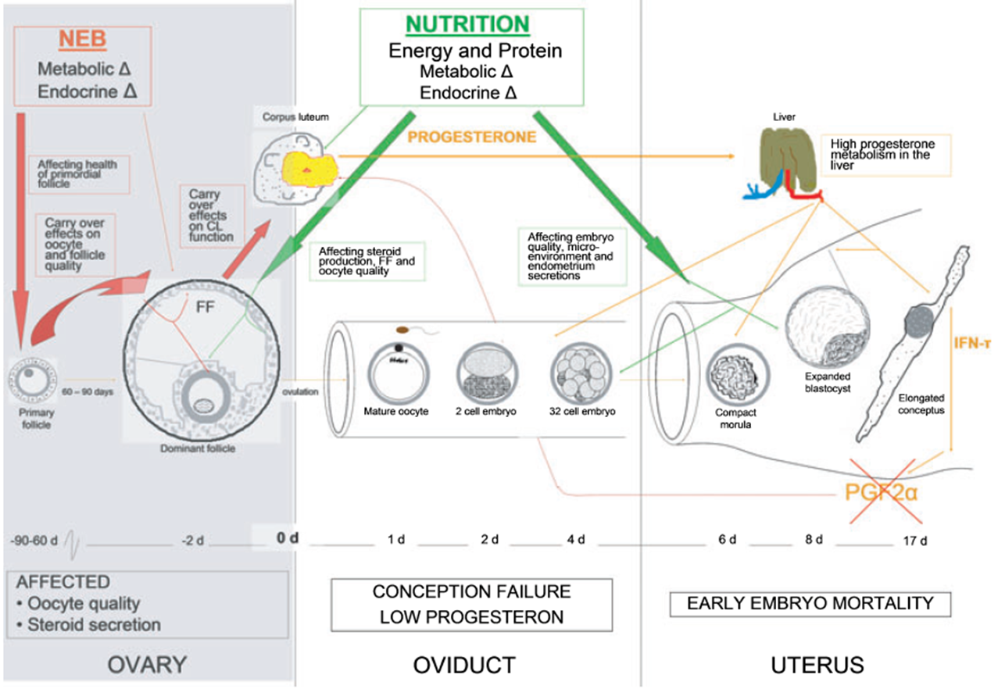
NEGATIVE Energy balance - IMPACTs
Energy balance is THE major driver of reproductive success in dairy cows
(LeRoy et al., 2008)

Slide 40
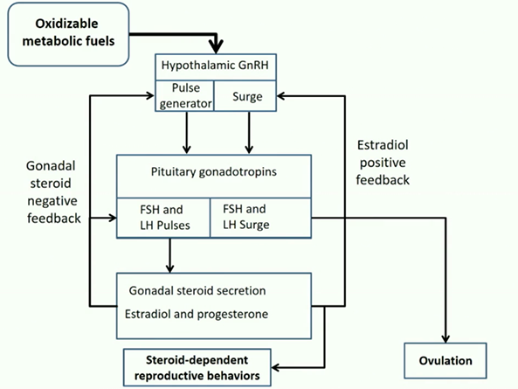
NEGATIVE Energy balance - IMPACTs
Energy balance is THE major driver of reproductive success in dairy cows
(Santos and Staples, 2016)

Slide 41
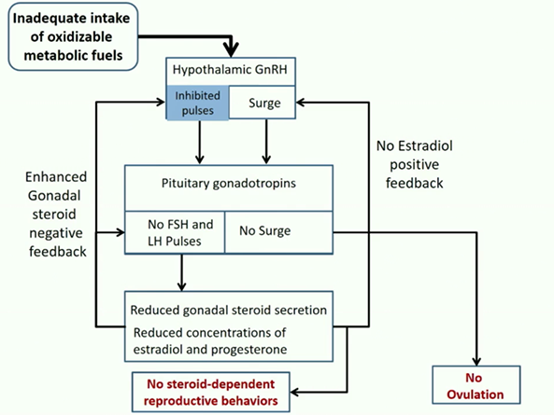
NEGATIVE Energy balance - IMPACTs
Energy balance is THE major driver of reproductive success in dairy cows
Negative Energy Balance (NEB) after calving inhibits ovulation (Santos and Staples, 2016)
(Santos and Staples, 2016)

Slide 42
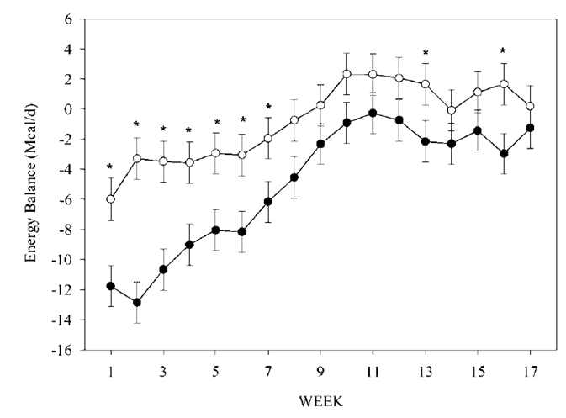
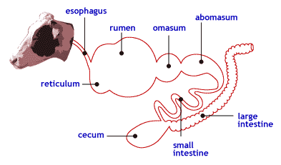

NEGATIVE Energy balance – FACTORS
1. BREED:
Jersey cows have a higher relative feed intake capacity than Holstein cows.
Oesophagus
GIT +10% /100kg BWt
Estimated energy balance of Jersey cows (○) and Holstein cows (●) from week 1 to week 17 of lactation (Rastani et al., 2001).

Slide 43
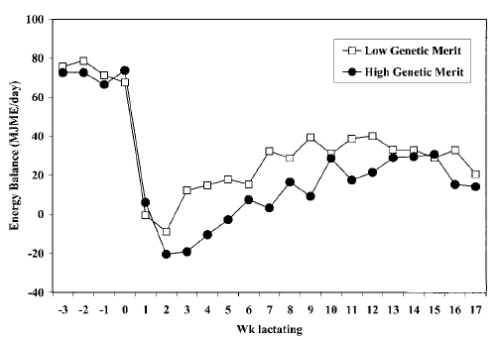
NEGATIVE Energy balance – FACTORS
2. GENETIC MERIT:
Cows of high genetic merit
have a lower EB nadir after calving, and are slower to return to positive EB than cows of lesser genetic merit.
(Westwood et al., 2000)

Slide 44
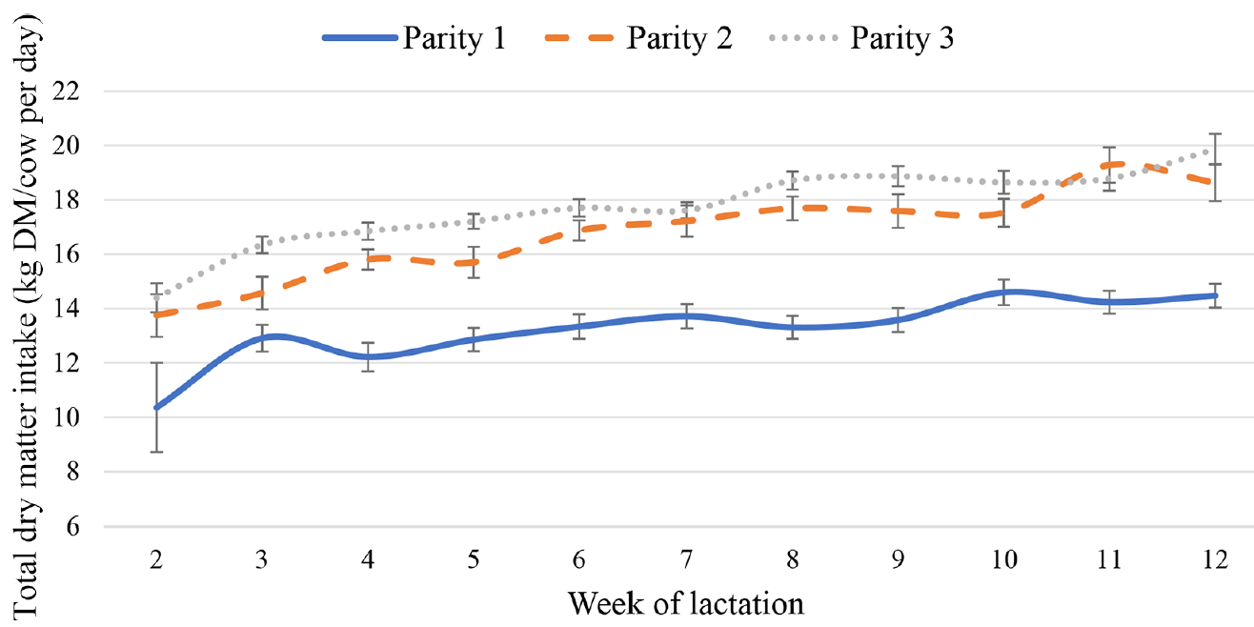
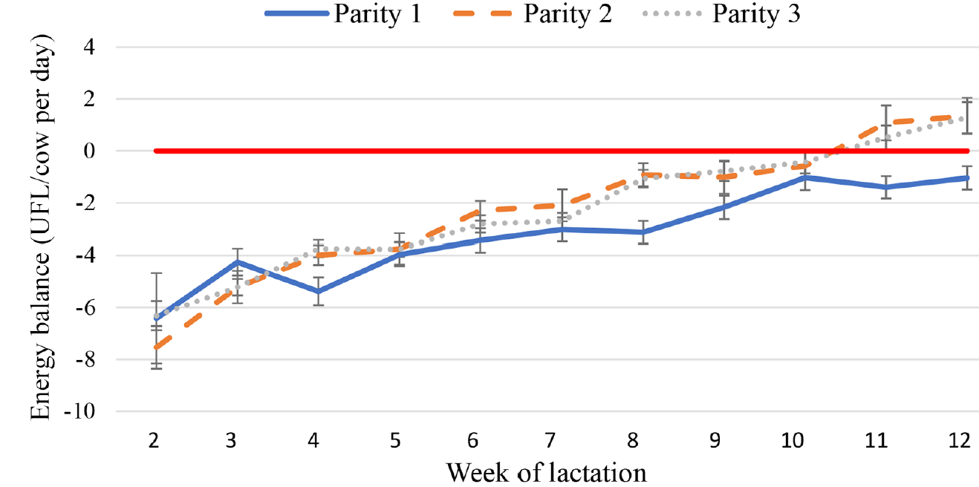
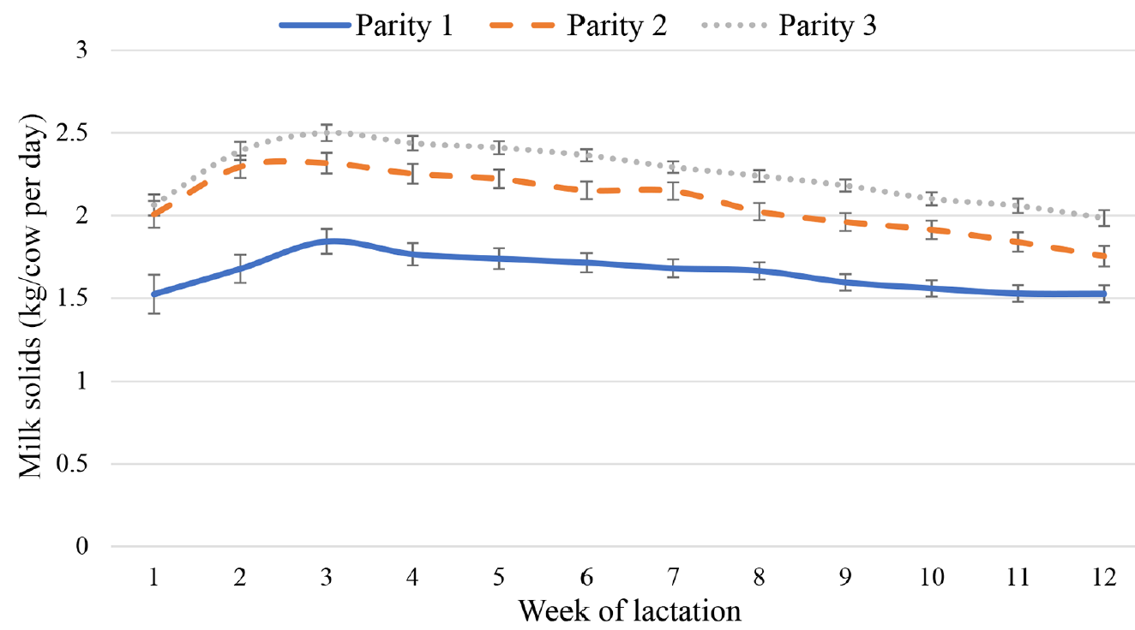
NEGATIVE Energy balance – FACTORS
3. PARITY:
Parity 1, 2 and 3 cows in a spring-calving pasture-based system from week 2 to week 12 of lactation (Walsh et al., 2024)
Peak at week 11
Strong +ve correlation (R₂=0.84)
Parity 2 & 3 cows: Greater bodyweight and rumen capacity
Parity 2 & 3 cows: Less time in NEB
Total DMI (grazed grass, grass silage and concentrate) of cows measured using the n-alkane technique.
Peak at week 3
No
correlation
Parity 1 cows: Lower DMI, mammary gland is less dense and metabolically active, some energy is partitioned to growth
Energy balance (UFL/cow per day) measured as the difference between energy requirement based on UFL needed for milk production, maintenance, and growth (animals <40 mo) and energy intake based on DMI of grazed grass, grass silage, and concentrate and the energy content of the feeds.
Milk solids production of cows.

Slide 45
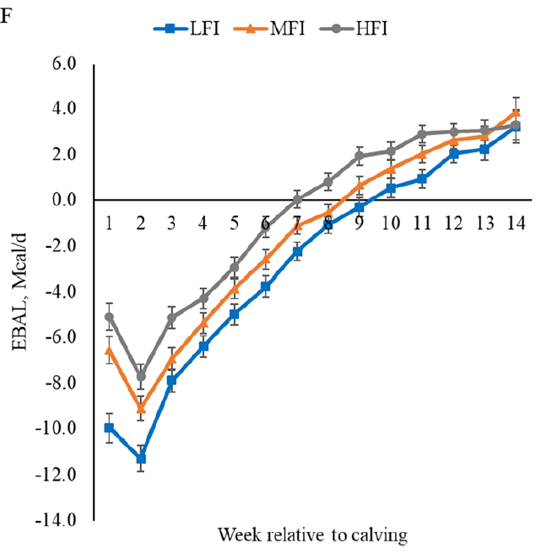
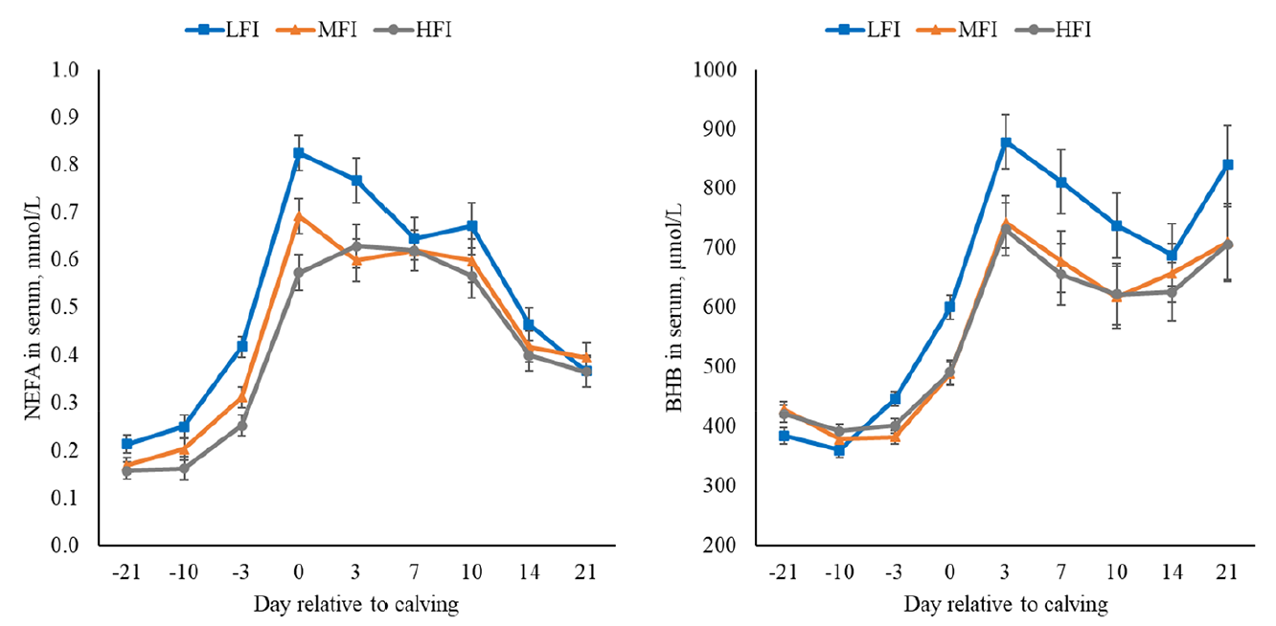
NEGATIVE Energy balance – FACTORS
4. FEED INTAKE PRE-CALVING:
Cows with more reduced feed intake pre-calving have deeper, more prolonged NEB, higher NEFA and BHB concentrations post-calving.
(Santos et al., 2024)

Slide 46
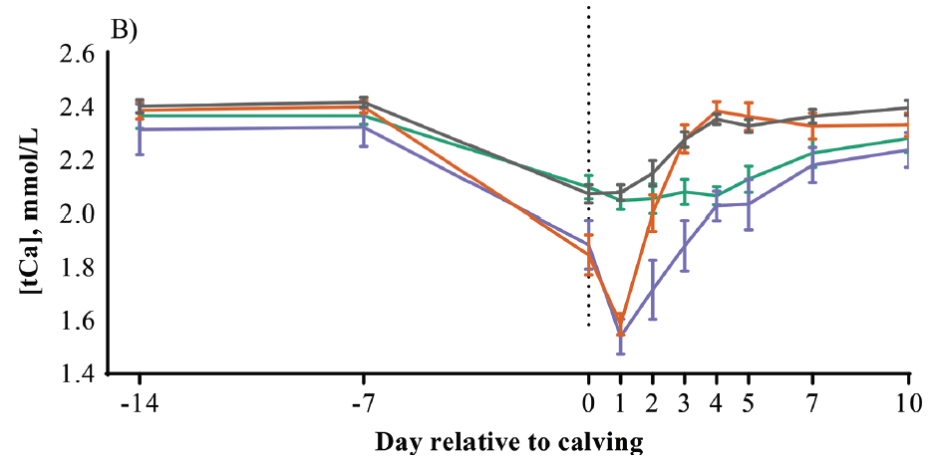

NEGATIVE Energy balance – FACTORS
5. EARLY POST-CALVING CALCIUM STATUS:
4 clusters of cows based on their blood Calcium concentrations in the first 4 days after calving:
NC = Normal
tSCH = Transient sub-clinical hypocalcaemia
pSCH = Persistent sub-clinical hypocalcaemia
dSCH = Delayed sub-clinical hypocalcaemia
(McArt and Neves, 2020).

Slide 47
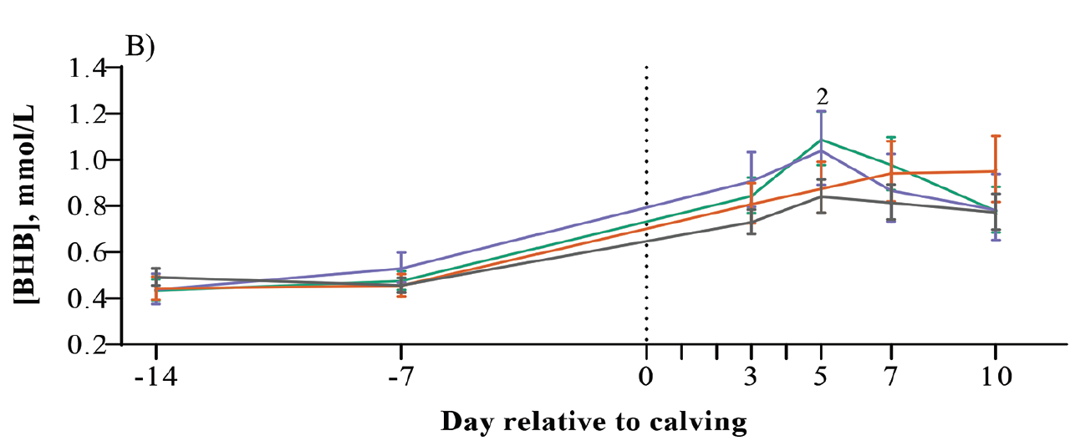
NEGATIVE Energy balance – FACTORS
5. EARLY POST-CALVING CALCIUM STATUS:
4 clusters of cows based on their blood Calcium concentrations in the first 4 days after calving:
NC = Normal
tSCH = Transient sub-clinical hypocalcaemia
pSCH = Persistent sub-clinical hypocalcaemia
dSCH = Delayed sub-clinical hypocalcaemia
(McArt and Neves, 2020).
pSCH and dSCH cows had numerically greater blood BHB concentrations than NC or tSCH cows at 5 DIM.
pSCH and dSCH cows had a much greater risk of early lactation disease or herd removal than NC cows, and milk yield, depending on parity group, was either no better or numerically worse than that of NC cows (McArt and Neves, 2020).

Slide 48
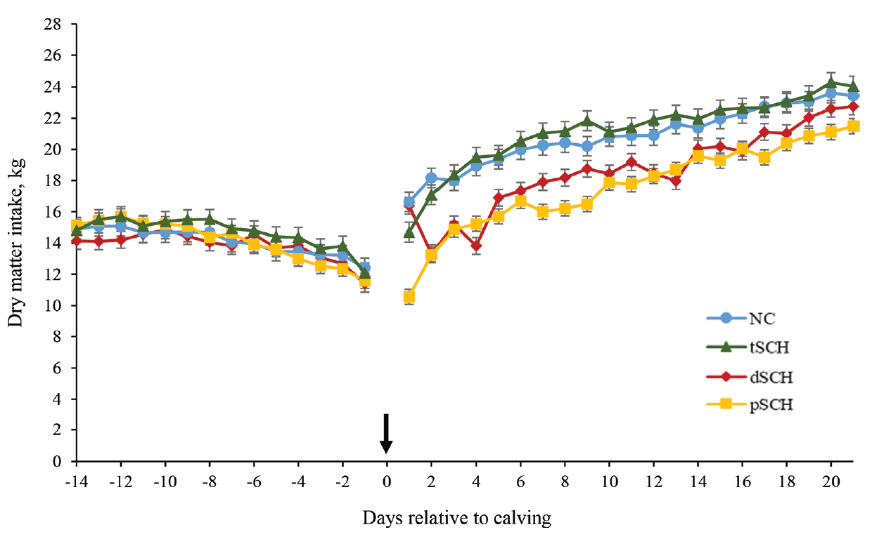
NEGATIVE Energy balance – FACTORS
5. EARLY POST-CALVING CALCIUM STATUS:
4 clusters of cows based on their blood Calcium concentrations in the first 4 days after calving:
NC = Normal
tSCH = Transient sub-clinical hypocalcaemia
pSCH = Persistent sub-clinical hypocalcaemia
dSCH = Delayed sub-clinical hypocalcaemia
(McArt and Neves, 2020).
Pre-calving feed intake was similar between groups, but the NC and tSCH cows consumed more feed than the pSCH or dSCH cows during the first 3 weeks of lactation (Seely et al., 2021).

Slide 49
NEGATIVE Energy balance – FACTORS
🤔
If the aim is to minimise NEB in the Fresh Period and Early Lactation to support high reproductive performance, how concerned should we be about higher yielding cows?
US study involving 6,000 cows
Variable | % cows cyclic | % cows in-calf
BCS change* from calving to 65 DIM
Lost 1 score or more | 59% | 29%
Lost < 1 score (1-5 scale) | 75% | 37%
No change | 81% | 42%
Milk yield in first 90 DIM
Quartile 1: 32.1 kg/day | 73% | 37%
Quartile 2: 39.1 kg/day | 78% | 39%
Quartile 3: 43.6 kg/day | 78% | 39%
Quartile 4: 50.0 kg/day | 75% | 38%
Avg. milk yield in the first 90 DIM had no significant effect on repro. performance.
(Santos et al., 2009)
Notes:
The experimental data from a study involving 6,000 cows shown in the tables below reinforces this conclusion.
As you can see, it was those cows that lost 1 unit or more body condition (on US 1-5 BCS scale) that were slowest to resume cycling after calving and get in-calf at first insemination. Average milk yield in the first 90 days of lactation had no significant effect.

Slide 50
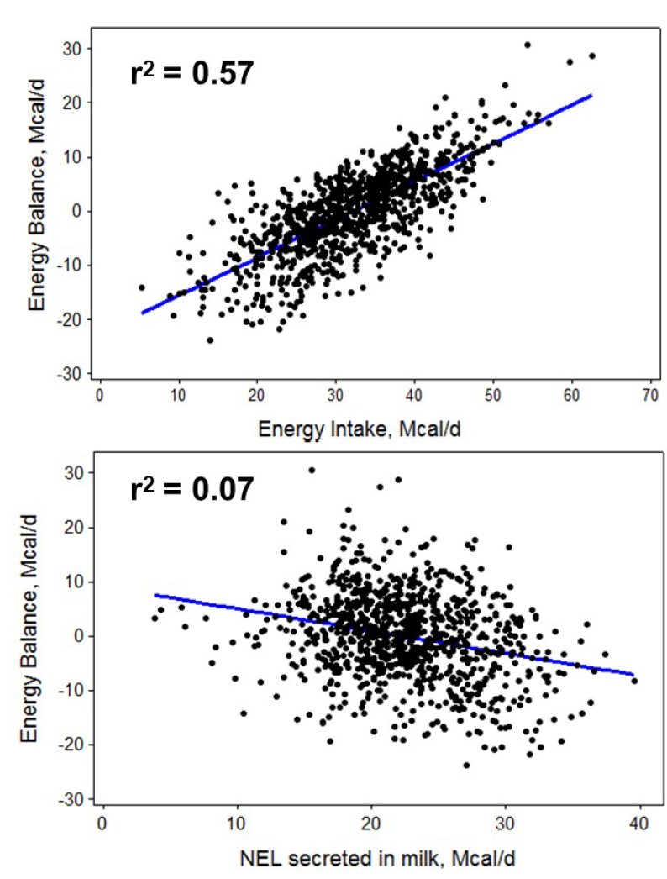
NEGATIVE Energy balance – FACTORS
🤔
If the aim is to minimise NEB in the Fresh Period and Early Lactation to support high reproductive performance, how concerned should we be about higher yielding cows?
Variation among cows in NEB is more related to feed intake than milk yield.
So to improve EB, increase DMI and energy density.
(Santos et al., 2010)

Slide 51
Metabolic CONTROL of feed intake & carry-over effects
2 different mechanisms control / limit cows’ feed intake (meal size and frequency) to varying extents through the phases of the lactation cycle:
PHYSICAL feed intake control
Rumen distension
  Energy demands (milk yield)
  Filling effect of diet
    Forage NDF content of diet (%)
    Rumen turnover rate of forage NDF
      NDF composition
      Particle size, bouyancy, fragility
      Rumen motility
METABOLIC feed intake control
Liver senses energy supply relative to energy demand
Signals pass from liver to brain up vagus nerve
Feeding behaviour is affected by the vagus nerve’s firing rate
  hepatic oxidation decreases firing rate = Satiety signal
  hepatic oxidation decreases firing rate = Hunger signal

Slide 52
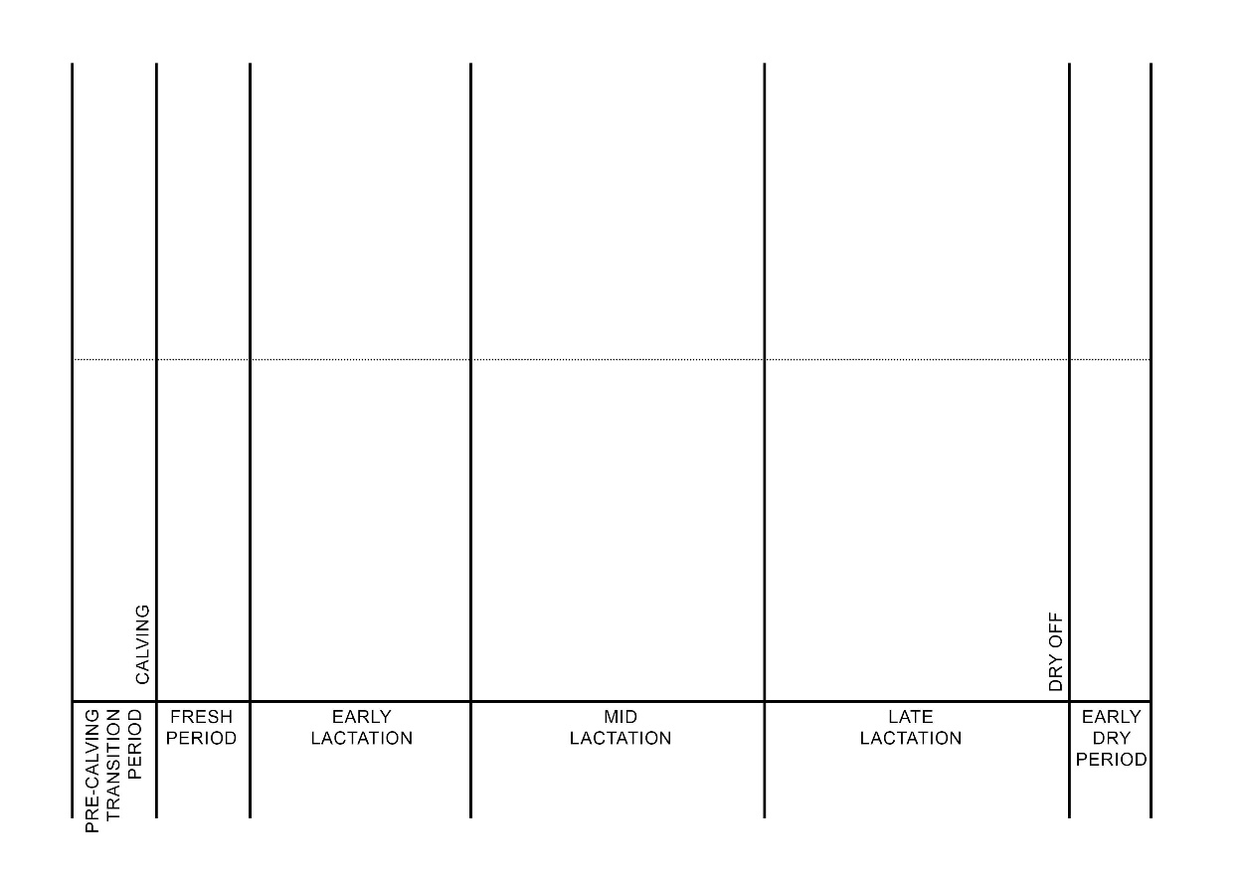
Metabolic CONTROL of feed intake & carry-over effects
ACTIVITY (in groups of 3):
On Worksheet 3, draw lines for:
METABOLIC feed intake control
PHYSICAL feed intake control.

Slide 53
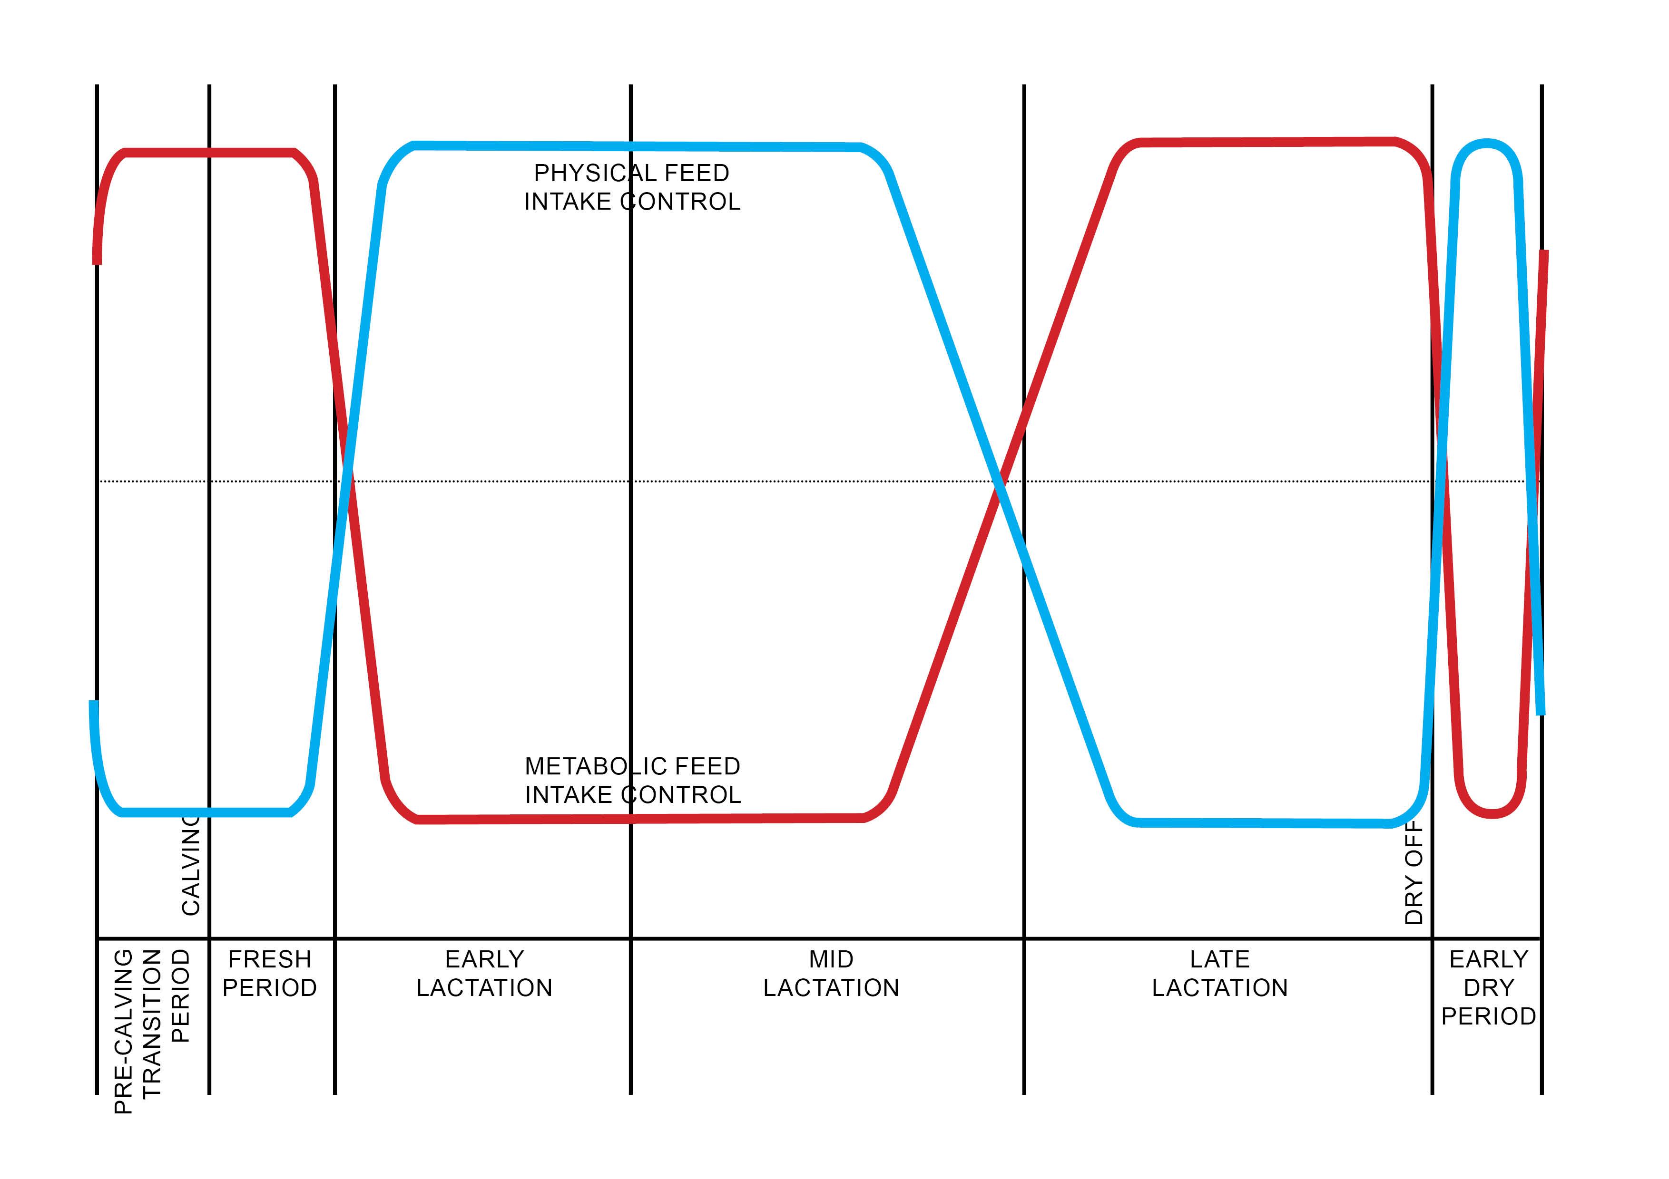
Metabolic CONTROL of feed intake & carry-over effects

Slide 54
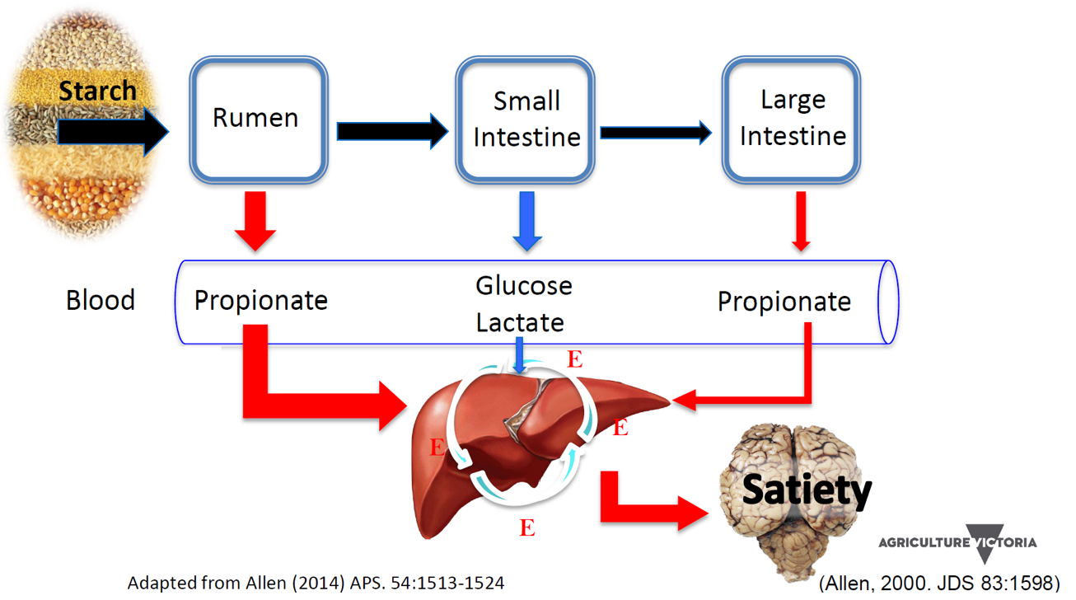
Metabolic CONTROL of feed intake & carry-over effects

Slide 55
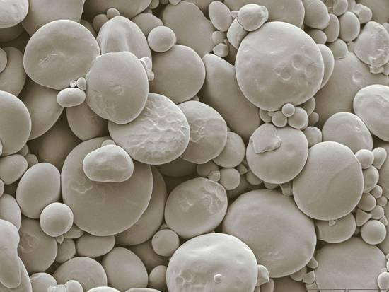



Metabolic CONTROL of feed intake & carry-over effects
A
B
ACTIVITY (in groups of 3):
Identify which of these electron micrographs A to D is:
Wheat
Barley
Corn
Sorghum
and explain your reasoning.
C
D

Slide 56
Metabolic CONTROL of feed intake & carry-over effects
A. Wheat
B. Barley
Corn and Sorghum are high in starch, but due to their structure require a higher degree of processing than other grains to optimise starch availability to the animal’s rumen microbes. This is due to the strong protein matrix in which the starch granules are embedded.
C. Sorghum
D. Corn

Slide 57

Metabolic CONTROL of feed intake & carry-over effects
In vivo ruminal starch and protein degradation (% of intake) of differently processed barley compared with wheat, corn and sorghum
(Nikkhah, 2012)

Slide 58


Metabolic CONTROL of feed intake & carry-over effects
Albornoz and Allen, 2018; Albornoz et al. 2019, 2020
– Effects of starch concentration and fermentability (MSU)
52 multiparous Holstein cows fed TMR 1X and milked 2X.
Fresh cow diets formulated with 22% or 28% starch with dry ground corn (DGC) or high-moisture corn (HMC).
From 24 to 72 DIM, all cows received same diet to measure carryover effects.
Results:

Slide 59

Metabolic CONTROL of feed intake & carry-over effects
Albornoz and Allen, 2018; Albornoz et al. 2019, 2020
– Effects of starch concentration and fermentability (MSU)
52 multiparous Holstein cows fed TMR 1X and milked 2X.
Fresh cow diets formulated with 22% or 28% starch with dry ground corn (DGC) or high-moisture corn (HMC).
From 24 to 72 DIM, all cows received same diet to measure carryover effects.
Results:

Slide 60


Metabolic CONTROL of feed intake & carry-over effects
First 100 Days project, Ellinbank, 2020 (Factsheet 1)
Cows were fed unrestricted high-quality lucerne hay 2X/day plus:
8 kg DM/day wheat grain mix
8 kg DM/day maize-grain mix
8 kg DM/day maize-grain mix + 350g/day protected fat supplement
for first 23 DIM
Results:
👍
+2.1 kg/cow/day
Treatment period
Daily dry matter intake of each treatment where lucerne hay was used as the forage base for the first 23 DIM.

Slide 61

Metabolic CONTROL of feed intake & carry-over effects
First 100 Days project, Ellinbank, 2020 (Factsheet 1)
Cows were fed unrestricted high-quality lucerne hay 2X/day plus:
8 kg DM/day wheat grain mix
8 kg DM/day maize-grain mix
8 kg DM/day maize-grain mix + 350g/day protected fat supplement
for first 23 DIM
Results:
👍
Carryover effect: +217 kg milk/cow
Treatment period
Carryover period
Energy corrected milk yield of each treatment across the 72 days of the experiment where lucerne hay was used as forage base for first 23 DIM.

Slide 62


Metabolic CONTROL of feed intake & carry-over effects
🤔
Is there any benefit from feeding fresh cows a TMR rather than pasture plus supplements?

Slide 63

Metabolic CONTROL of feed intake & carry-over effects
Brady et al., 2021
– Effects of pasture-based diet vs TMR for first 30 DIM
Holstein cows fed either:
Ad-lib pasture and concentrate in bail (CTR), or
Ad-lib total mixed ration (TMR).
for first 30 DIM, as typical on farms.
From 31 to 100 DIM, all cows then received the same diet (ad-lib pasture and 3kg concentrate) to measure carryover effects.
Results:
TMR = +1.2kg DMI/day, but similar milk yield
👍
TMR = +1.7kg milk/cow/day
Treatment period
Carryover period
Milk yield (kg/cow/day) of cows fed under different feeding strategies.

Slide 64



Metabolic CONTROL of feed intake & carry-over effects
Brady et al., 2021
– Effects of pasture-based diet vs TMR for first 30 DIM
Holstein cows fed either:
Ad-lib pasture and concentrate in bail (CTR), or
Ad-lib total mixed ration (TMR).
for first 30 DIM, as typical on farms.
From 31 to 100 DIM, all cows then received the same diet (ad-lib pasture and 3kg concentrate) to measure carryover effects.
Results:
Mean blood NEFA and BHB concentrations in cows fed under different feeding strategies in first 28 DIM.
🤔
WHY might offering a TMR for the first 30 DIM have improved cows’ milk production and energy status to 100 DIM?

Slide 65

Metabolic CONTROL of feed intake & carry-over effects
Typical rumen pH pattern over a 24-hour period
Feeding system:
TMR
PMR
Pasture + grain
Pasture only
(Heard and Wales, 2009)

Slide 66

MP and AA SUPPLY
🤔
Why may increasing MP and AA supply be more important for fresh cows than increasing energy supply?

Slide 67

MP and AA SUPPLY
Increasing MP and AA supply may be more important for fresh cows than increasing energy supply.
During Fresh Period, demand for Essential Amino Acids is increased due to:
  Increase in intestinal mass to adapt to high DMI of higher energy lactation diets
  Cows are in negative MP balance because dietary protein intake is outpaced by milk protein output
  Some AA in muscle are converted to glucose in response to NEB
  Many EAA are taken up by the mammary gland in excess of milk output (especially BCAA and Arginine)
  (McCabe & Boerman, 2020)

Slide 68

MP and AA SUPPLY
Increasing MP and AA supply may be more important for fresh cows than increasing energy supply.
Body weight (kg), longissimus dorsi depth (cm), and backfat depth (cm) across lactation by muscle group.
Gold lines indicate high muscle cows (HM; longissimus dorsi depth > 5.0 cm at calving).
Black lines indicate low muscle cows (LM; longissimus dorsi depth ≤ 5.0 cm at calving)
(Hanno et al, 2024).
Cows have less capacity to mobilise muscle than body fat
  Thin cows mobilise more muscle tissue than cows with higher BCS as they try to fill the energy deficit after calving
  Muscle loss is asynchronous with back fat loss, indicating that NEB is not the sole or primary initiator of mobilisation of muscle tissue around calving

Slide 69

MP and AA SUPPLY
Increasing MP and AA supply may be more important for fresh cows than increasing energy supply.
AA profile of muscle is not a perfect match for milk protein
  Essential AA = almost half of total AA in milk protein
  Branched Chain AA = 44% of EAA in milk, but only 35% in muscle
(McCabe & Boerman, 2020)

Slide 70

MP and AA SUPPLY
Increasing MP and AA supply may be more important for fresh cows than increasing energy supply.
Excessive muscle loss to 60 DIM impacts on cow’s reproductive performance:
  Commencement of luteal activity found to be associated with muscle loss and BCS loss
  Time to first oestrus found to be associated with muscle loss, but not BCS change or back fat loss
    Muscle loss > 8mm: least likely to commence oestrus
  Oestrus behaviour also found to be associated with muscle loss
    Muscle loss > 8mm: least likely to be detected on heat
  (Hatfield et al., 2022; Ryder et al., 2023).

Slide 71
MP and AA SUPPLY
🤔
We have discussed how the benefits of feeding a moderately rumen degradable starch source like corn grain in the Fresh Period can have a carryover benefit into early lactation.
So is there also a carryover benefit from providing higher MP and AA supply in the Fresh Period?

Slide 72


MP and AA SUPPLY
Tebbe and Weiss, 2021a and 2021b
Results:
Study of effects of feeding TMR diets with different concentrations of MP, AA profile, or forage NDF (fNDF) concentrations on DMI and milk yield during the first 25 DIM in primiparous and multiparous cows.
= 20% deficient in MP
= Adequate MP using primarily soy
to increase RUP concentration
= Adequate MP using a blend of
RUP and AA sources
= Blend replacing forage rather than
nonforage NDF sources
From 26 to 92 DIM, all cows received the same TMR.

Slide 73

MP and AA SUPPLY
Tebbe and Weiss, 2021a and 2021b
Results:
Study of effects of feeding TMR diets with different concentrations of MP, AA profile, or forage NDF (fNDF) concentrations on DMI and milk yield during the first 25 DIM in primiparous and multiparous cows.
= 20% deficient in MP
= Adequate MP using primarily soy
to increase RUP concentration
= Adequate MP using a blend of
RUP and AA sources
= Blend replacing forage rather than
nonforage NDF sources
From 26 to 92 DIM, all cows received the same TMR.
👍
Multiparous
Carryover effect
Primiparous
Treatment period
Carryover period
In mature cows, providing increased MP supply with a good AA balance during Fresh Period had a carryover effect.

Slide 74

MP and AA SUPPLY
First 100 Days project, Ellinbank, 2020 (Factsheet 2)
Results:
Cows were fed pasture plus 9kg DM/day of a maize grain mix including:
0 kg DM/day canola meal
1.5 kg DM/day canola meal
3 kg DM/day canola meal
for first 30 DIM.
From 31 to 72 DIM, all cows received the same diet of grazed pasture and a common concentrate.
No carryover effect
Treatment period
Carryover period
Daily milk yield of each group during the treatment period (1–30 DIM; 9 kg DM/cow of each treatment grain mix offered) and the subsequent carryover period (31–72 DIM; 7kg DM of the same supplement offered to all cows).

Slide 75
MP and AA SUPPLY
ACTIVITY (in groups of 3):
On butcher’s paper, write down possible reasons why a CARRYOVER EFFECT from increased protein supply in the Fresh Period may have been observed in the Tebbe & Weiss study but not in the Ellinbank study.

Slide 76

MP and AA SUPPLY
The proportion of dietary crude protein which bypasses the rumen (UDP) and is digested in the intestine depends on the feed retention time in the rumen, which is shorter in high yielding cows.
(Adapted from Chamberlain and Wilkinson, 1998)

Slide 77

Fat supplementation
Feeding fats has a positive effect on fertility and a tendency to increase milk production when fed in the Pre-calving Transition Period and post-calving into Early Lactation (Rodney et al., 2015).
(Rodney et al., 2015)

Slide 78

Fat supplementation
Feeding fats has a positive effect on fertility and a tendency to increase milk production when fed in the Pre-calving Transition Period and post-calving into Early Lactation (Rodney et al., 2015).
(Rodney et al., 2015)

Slide 79

Fat supplementation
Feeding fats has a positive effect on fertility and a tendency to increase milk production when fed in the Pre-calving Transition Period and post-calving into Early Lactation (Rodney et al., 2015).
More good news:
dos Santos Neto et al., 2024 found that including calcium salts of palm fatty acids at
up to 0.6 kg/d from 20 to 110 DIM consistently increased
milk yield and had a carryover benefit into later lactation.
👍
Carryover effect
Treatment period
Carryover period
Milk yield over time during treatment and carryover period (n = 40). Inclusion of 4 levels of calcium salts of palm fatty acids (CSPF) replacing a corn-based supplement: 0 kg/d), 0.2 kg/d), (3) 0.4 kg/d), and 0.6 kg/d) (dos Santos Neto et al., 2024).

Slide 80

Fat supplementation
🤔
What are some key considerations when using fat supplements to help improve cow fertility?
(Leroy et al., 2008)

Slide 81


CALCIUM BALANCE
Demand
Supply
Positive Ca balance
Negative Ca balance
(Horst, 1986)
(Lean & DeGaris, 2021)

Slide 82

Impacts of heat stress on ferTility
Effects of heat stress on conception rate extend from 105 days before insemination to 7 days after insemination.
Heat stress can affect oocyte competence for follicular development and fertilization. Oocytes can be damaged by heat stress as early as 105 days before ovulation.
Following fertilisation, in the early stages of cleavage, the embryo is also vulnerable to heat stress (days 1 to 7). Thermal tolerance then increases by the morula stage.
The timing of heat shock (hyperthermal) effects on events leading to blastocyst formation (Hansen, 2013).

Slide 83

NEGATIVE Energy balance - IMPACTs
ACTIVITY (in groups of 3):
In the bottom section of Worksheet 2, draw lines for:
IMMUNE CAPACITY
INFLAMMATION
OXIDATIVE STRESS.

Slide 84

NEGATIVE Energy balance - IMPACTs

Slide 85

NEGATIVE Energy balance - IMPACTs

Slide 86

NEGATIVE Energy balance - IMPACTs

Slide 87

Systemic inflammation
Mobilisation of body fat during NEB and the associated increase in plasma NEFA concentration may contribute to the inflammatory response / oxidative stress that occurs in cows in early lactation, as evidenced by:
Increased pro-inflammatory cytokines
Increased synthesis of positive APP e.g. haptoglobin and ceruloplasmin
Reduced synthesis of negative APP e.g. albumin
Stressors that contribute to systemic inflammation (Bradford et al., 2015)

Slide 88
Session 4.
EARLY LACTATION – Optimising cow productivity and profit
PRE-CALVING TRANSITION PERIOD
FRESH
PERIOD
EARLY LACTATION
88

Slide 89
SESSION 4: EARLY LACTATION
In this session you will:
Consider factors affecting response to supplements in grazing systems,
Discuss the production function and formula for maximum profit, and
Compare alternative concentrate feeding strategies, drawing on recent research.
89

Slide 90


Feeding supplements in grazing systems - Maximising profit
We seek to maximise profit, not milk production, using marginal thinking.
Production function
(Malcolm, 2013)
90

Slide 91


Feeding supplements in grazing systems - Maximising profit
Example of production functions
= Perennial ryegrass pasture, milled barley
fed in parlour and pasture silage in paddock
= Same pasture and same milled barley and
pasture silage presented as a mixed ration
after each milking
= Same pasture and mixed ration of milled
barley, alfalfa hay, corn silage and crushed
corn grain after each milking
🤔
What benefits may a supplement provide further to the immediate, marginal milk response?
(Auldist et al., 2013)
91

Slide 92



Alternative concentrate feeding strategies
92

Slide 93
Alternative concentrate feeding strategies
A pasture-based dairy farm with 500 cows has been flat-rate feeding a grain-mix in a rotary dairy. Cow collars and a herd management system are used to help detect heats. A computerised in-parlour feeding system is now being installed with 4 feed heads and silos.
ACTIVITY (in groups of 3):
On butcher’s paper, write down PARAMETERS that could potentially be used TO ALLOCATE MULTIPLE CONCENTRATE SUPPLEMENTS TO INDIVIDUAL COWS using the new feeding system.
93

Slide 94



Alternative concentrate feeding strategies
IMPACT OF MILKING ORDER
Smart Feeding project, Ellinbank: Experiments with grazing cows
94

Slide 95

Alternative concentrate feeding strategies
IMPACT OF MILKING ORDER
Smart Feeding project, Ellinbank: Experiments with grazing cows
Factsheet 1:
Changes in pasture quality during grazing session after first cows entered paddock:
Metabolisable energy (ME) of pasture declined by 0.2 MJ/kg DM per hour,
Crude protein (CP) concentration in pasture declined by 0.87% per hour, and
Neutral detergent fibre (NDF) increased by 0.97% per hour.
95

Slide 96


Alternative concentrate feeding strategies
IMPACT OF MILKING ORDER
Smart Feeding project, Ellinbank: Experiments with grazing cows
Factsheet 1:
Cows that returned to the paddock first had a net benefit per day of $2.48 per cow more than cows that returned to the paddock last.
96

Slide 97


Alternative concentrate feeding strategies
IMPACT OF MILKING ORDER
Smart Feeding project, Ellinbank: Experiments with grazing cows
Factsheet 3: Early lactation cows. 2 groups: Return to paddock immediately T0:00)
Return to paddock 3 hours later (T3:00)
Control cows:
T0:00 and T3:00 groups grazed same area together and were fed 6 kg DM of concentrate.
Reallocation cows:
T0:00 and T3:00 cows grazed same area together and were fed 4 kg and 8 kg DM of concentrate respectively.
Combination cows:
T0:00 and T3:00 cows grazed half area each and were fed 4 kg and 8 kg DM of concentrate respectively.
97

Slide 98

Alternative concentrate feeding strategies
For individualised feeding to provide a benefit over flat rate feeding, there must be:
Significant between-cow variation in DMI and response to supplementation, and
Profitable economic response obtainable from exploiting this variability.
Liebig’s principle: the “cascade of nutritional limitations”
on milk production.
Under conditions where forage supply is not limiting (> 30 kg DM/cow/day), research studies have found no strong evidence to support stepped or individualized feeding vs flat rate feeding.
Under conditions where pasture allowance is restricted, cows compete for pasture, leading to variation in the relative deficit between nutrient supply and demand for cows in the herd.
🤔
Which cows in a herd are likely to have the greater nutrient deficit?
98

Slide 99
Alternative concentrate feeding strategies
For individualised feeding to provide a benefit over flat rate feeding, there must be:
Significant between-cow variation in DMI and response to supplementation, and
Profitable economic response obtainable from exploiting this variability.
Liebig’s principle: the “cascade of nutritional limitations”
on milk production.
Under conditions where forage supply is not limiting (> 30 kg DM/cow/day), research studies have found no strong evidence to support stepped or individualized feeding vs flat rate feeding.
Under conditions where pasture allowance is restricted, cows compete for pasture, leading to variation in the relative deficit between nutrient supply and demand for cows in the herd.
🤔
What other roles could individualised feeding play, apart from increasing milk production and more efficiently using feeds, in supporting cow health and productivity?
99

Slide 100


Alternative concentrate feeding strategies
First 100 Days project, Ellinbank: Experiments with grazing cows
Factsheet 3: 15-100 DIM: 4 different grain mixes, fed @ 9 kg/cow/day
(4 treatments) 101-200 DIM: Common diet
Spring calving cows grazing pasture at daily allocation of 35 kg DM/cow.
100

Slide 101

Alternative concentrate feeding strategies
First 100 Days project, Ellinbank (Factsheet 3)
Results:
No carryover effect
Treatment period
Carryover period
101

Slide 102


Alternative concentrate feeding strategies
First 100 Days project, Ellinbank (Factsheet 3)
Results:
102

Slide 103

Alternative concentrate feeding strategies
First 100 Days project, Ellinbank (Factsheet 3)
Results:
103

Slide 104
Alternative concentrate feeding strategies
ACTIVITY (in groups of 3):
Read the factsheet allocated to you (4, 5, 6 or 7).
Use the fluorescent highlighter pen provided to highlight the key findings.
Be ready to share these findings briefly with everyone.
104

Slide 105


Alternative concentrate feeding strategies
First 100 Days project, Ellinbank: Experiments with grazing cows
Factsheet 4: 14-118 DIM: T3 grain mix as per Factsheet 3, fed using 4 different strategies
(4 treatments) 119-200 DIM: Common grain mix @ 7kg/cow/day
The reduction in grain for treatment groups 70DIM and LWG occurred gradually over a 2-week period, reducing by ~0.3 kg DM/cow per day. On average cows in the LWG treatment started to gain weight and had their grain allocation switched from 9kg DM to 5 kg DM at 66 days in milk (+/- 15 days).
105

Slide 106

Alternative concentrate feeding strategies
First 100 Days project, Ellinbank (Factsheet 4)
Results:
👍
Carryover effect
Treatment period
Carryover period
106

Slide 107


Alternative concentrate feeding strategies
First 100 Days project, Ellinbank (Factsheet 4)
Results:
107

Slide 108

Alternative concentrate feeding strategies
First 100 Days project, Ellinbank (Factsheet 4)
Results:
When the cost of pasture was also accounted for, the profitability of the HI, MED and 70 DIM diets was still similar: $9.59, $9.17 and $9.47 /cow/day respectively.
108

Slide 109


Alternative concentrate feeding strategies
First 100 Days project, Ellinbank: Experiments with grazing cows
Factsheet 5: 5-21 DIM: Wheat OR Maize grain @ 5 kg/cow/day
(8 treatments) 22-130 DIM: Wheat or T3 grain mix as per Factsheet 3, fed using 3 different strategies
131-200 DIM: Common diet
In Fresh Period (5-21 DIM), cows fed either 4 kg Wheat or Maize grain plus 1 kg Canola meal plus grazed pasture.
In Early Lactation (22-130 DIM), cows then fed one of 4 grain mix treatments:
7 kg Wheat (Flat wheat)
7 kg grain mix T3 from previous experiment (Factsheet 3) (Flat grain mix)
7 kg grain mix T3 from 22-70 DIM, then 5 kg from 71-130 DIM (70 DIM)
7 kg grain mix T3 initially, then adjusted up or down by 1 kg each week for each cow based on milk income minus cost of grain mix (Profit).
109

Slide 110

Alternative concentrate feeding strategies
First 100 Days project, Ellinbank (Factsheet 5)
Results:
Treatment period
Carryover period
110

Slide 111

Alternative concentrate feeding strategies
First 100 Days project, Ellinbank (Factsheet 5)
Results:
Treatment period
Carryover period
111

Slide 112


Alternative concentrate feeding strategies
First 100 Days project, Ellinbank (Factsheet 5)
Results:
112

Slide 113

Alternative concentrate feeding strategies
First 100 Days project, Ellinbank (Factsheet 5)
Results:
Using maize grain in the Fresh Period resulted in higher profit (milk income minus cost of grain mix) for three of the four subsequent Early Lactation treatments.
Maize appeared to have a programming effect on cows when offered in the Fresh Period.
As shown in other experiments, the presence of canola meal in the grain mix stimulated higher intake of grazed pasture (and subsequent milk production).
Changing the grain allocation each week based on each cow’s weekly estimated profit did not provide any additional benefit over flat rate feeding.
113

Slide 114


Alternative concentrate feeding strategies
First 100 Days project, Ellinbank: Experiments with grazing cows
Factsheet 6: 5-21 DIM: Wheat OR Maize grain+Canola meal @ 7 kg/cow/day
(6 treatments) 22-100 DIM: T3 grain mix as per Factsheet 3, using 5 strategies
based on cows’ nutrient requirement (H/M/L)
119-200 DIM: Common diet
In Fresh Period (5 to 21 DIM):
Control cows fed 7 kg Wheat / day plus grazed pasture
All other cows fed 6 kg Maize grain and 1 kg Canola meal / day plus grazed pasture.
In Early Lactation (22-100 days):
Control cows fed flat rate of 7 kg Wheat / day
Other cows fed different rates of grain mix T3 from previous experiment (Factsheet 3) plus grazed pasture based on their nutrient requirement between 7-14 DIM (High / Medium / Low).
114

Slide 115

Alternative concentrate feeding strategies
First 100 Days project, Ellinbank (Factsheet 6)
Results:
Consistent with earlier 100 Days experiments, cows offered the grain mix containing wheat grain, barley grain and canola meal produced more milk than cows offered wheat alone, at the same 7 kg DM rate of grain feeding.
Treatment period
Carryover period
115

Slide 116

Alternative concentrate feeding strategies
First 100 Days project, Ellinbank (Factsheet 6)
Results:
The type of concentrate fed appears to be more influential than feeding different amounts to various sub-groups within the herd, with mixes including canola meal consistently performing better.
Several variations of differential feeding in Early Lactation have been tested in the First 100 Days project. None have shown much advantage over feeding based on the nutritional requirements of the average cow in the herd.
Treatment period
Carryover period
116

Slide 117

Alternative concentrate feeding strategies
First 100 Days project, Ellinbank (Factsheet 6)
Results:
Different pasture substitution rates were demonstrated in this experiment.
Economic analysis:
Feeding a flat rate of the grain mix was more profitable than feeding wheat.
While the average profitability of all cows in the high and low nutritional requirement groups combined was marginally higher than the average profit of all cows in the high and low nutritional requirement control groups combined, the difference was very small, so there was no meaningful advantage in differentially feeding cows in this experiment.
117

Slide 118


Alternative concentrate feeding strategies
First 100 Days project, Ellinbank: Experiments with grazing cows
Factsheet 7: 1-21 DIM: Wheat OR Maize grain+Canola meal @ two different rates
(7 treatments) 22-100 DIM: Wheat or T3 grain mix as per Factsheet 3, using 3 different strategies
101-200 DIM: Common diet
In Fresh Period (1 to 21 DIM):
‘Wheat’ cows fed 7 kg Wheat / day plus grazed pasture
‘Maize 1C’ cows fed 6 kg Maize grain and 1 kg Canola meal / day plus grazed pasture
‘Maize 3C’ cows fed 6 kg Maize grain and 3 kg Canola meal / day plus grazed pasture
In Early Lactation (22-100 DIM):
‘Wheat’ cows fed flat rate of 7 kg Wheat / day
‘Maize 1C’ cows and ‘Maize 3C’ cows fed:
  Grain mix T3 from previous experiment (Factsheet 3) at 9 kg (High) or 7 kg (Medium) and plus grazed pasture
  7 kg grain mix T3 initially, then adjusted up or down by 1 kg each fortnight for each cow based on milk income minus cost of grain mix (Profit) plus grazed pasture.
118

Slide 119

Alternative concentrate feeding strategies
First 100 Days project, Ellinbank (Factsheet 7)
Results:
Is no additional advantage from feeding the higher level of canola meal.
Cows fed both combinations of maize grain plus canola meal in the Fresh Period, followed by a wheat grain, barley grain and canola meal mix in Early Lactation, performed better than cows fed only wheat throughout at the same rate of feeding. The advantage persisted in carryover period from 101-200 DIM.
Canola meal supplementation stimulated higher pasture intake and milk production.
👍
Carryover effect
Treatment period
Carryover period
119

Slide 120

Alternative concentrate feeding strategies
First 100 Days project, Ellinbank (Factsheet 7)
Results:
Cows on the Wheat control treatment produced substantially lower milk solids than cows
offered the other treatments.
There was no difference between the High treatments compared to the Medium and Profit treatments despite these cows receiving approximately 2 kg DM less grain per cow from
22–100 DIM.
120

Slide 121

Alternative concentrate feeding strategies
First 100 Days project, Ellinbank (Factsheet 7)
Profit treatment had no milk yield benefit over feeding a flat rate of grain mix at a similar rate (Medium treatment).
The daily concentrate intake did not differ between cows on the Medium and Profit treatments (both 7 kg DM/cow).
This aligns with earlier experiments in First 100 Days project and suggests that pasture-based dairy farmers will not gain additional benefits from implementing more complex differential feeding strategies at the individual cow level.
Results:
👍
Carryover effect
Treatment period
Carryover period
121

Slide 122

Alternative concentrate feeding strategies
First 100 Days project, Ellinbank (Factsheet 7)
Results:
The wheat mix was just under $100/t DM cheaper than the maize grain and canola meal mixes used in the Fresh Period, while the wheat grain, barley grain and canola meal mix used from 22-100 DIM was approximately $20/t DM more expensive than the wheat alone.
Cows offered either of the maize grain plus canola meal treatments in the Fresh Period were more profitable than cows fed wheat only. (Maize 1C and Maize 3C diets were $0.94 and $1.10/cow per day more profitable than the Wheat treatment).
The combined effect of the Fresh Period and Early Lactation diets was varied, but all were more profitable than the Wheat control diet over the first 100 DIM.
Milk income minus feed cost ($)
122

Slide 123
Alternative concentrate feeding strategies
First 100 Days project, Ellinbank (Factsheets 1 - 7)
Factsheet: | 1 | 2 | 3 | 4 | 5 | 6 | 7
Feeding maize grain instead of wheat in the Fresh Period increased DMI and milk production when fed with a high quality forage (lucerne hay), with a carryover milk yield benefit into Early Lactation. | X |  |  |  |  |  | X
Feeding canola meal in the Fresh Period increased milk production, without a carryover milk yield benefit. |  | X |  |  |  |  | X
Canola meal / wheat / barley grain mix in Early Lactation gave a greater pasture DMI, milk production and profit per cow per day than straight wheat grain. |  |  | X |  |  | X | X
Feeding canola meal / wheat / barley grain mix in Early Lactation at a high level had a carryover milk yield benefit into Mid Lactation. |  |  |  | X
Feeding maize grain in the Fresh Period followed by canola meal / wheat / barley grain mix in Early Lactation had a carryover milk yield benefit into Mid Lactation. |  |  |  |  |  |  | X
Differentially feeding cows in early lactation, based on high/medium/low nutritional requirements or profit, did not improve milk production or profit per cow per day vs flat rate feeding or stepped feeding based on DIM or Bodyweight change, when pasture allowance was greater than 30 kg DM/cow/day. |  |  |  | X | X | X | X
Grazing cows
123

Slide 124
Session 5.
Helping farmers develop and implement strategies to improve cows’ nutrition, management and profit in the first 100 DIM
124

Slide 125
4 ALTERNATIVE FRESH COW MANAGEMENT STRATEGIES
A. | Keep fresh cows in milking herd, utilise in-parlour computerised feeding system to feed fresh cows maize grain instead of wheat/barley and step up their concentrate intake gradually over first 21 DIM
B. | Use auto. drafting to separate fresh cows from milking herd after am milking and hold them in a shady area near the dairy until pm milking to reduce daily walking distance and competition for forage
C. | Run a separate fresh cow herd for cows up to 30 DIM (with its own grazing rotation)
D. | Run a separate fresh cow herd for cows up to 30 DIM (housed, fed TMR)
125

Slide 126
ACTIVITY (4 bus stops):
4 ALTERNATIVE FRESH COW MANAGEMENT STRATEGIES
Go to each of the 4 stations in the room and write down things you need to consider and get right concerning animals, feed, facilities and people to set up and operate fresh cow management strategy A / B / C / D successfully on a farm.
These may be things you need to set up and manage, choices to be made, information collected, decisions and actions taken.
126

Slide 127

THREE STEP PROCESS
Co-develop a change strategy with each farmer
Help farmer implement their action plan and continuously improve
Acquire latest technical knowledge
Cow nutrition, management and profit in the first 100 days in milk:
  Pre-calving Transition Period
  Fresh Period
  Early Lactation
What things do we need to be very good at? (Key performance areas)
What does it mean to be very good at each of these things? (Capabilities required)
Action plan:
  Short-term actions
  Long-term actions
127

Slide 128

FORCE FIELD ANALYSIS for a Change Strategy – an example
128

Slide 129
Session 6.
Summary / Where to from here
129

Slide 130
TAKE-HOME MESSAGES
Sustaining high feed intake in the last few weeks of pregnancy leads to improved cow health and production in the first 100 DIM.
Effects of heat stress on conception rate extend from 105 days before insemination to 7 days after insemination.
Keeping late gestation cows cool during hot weather is critical to avoid reductions in:
  cow’s lactation and reproductive performance in their subsequent lactation
  their daughters and grand-daughters’ lifetime performance and survival
Negative energy balance has many impacts on cows’ health and fertility.
Feeding maize grain instead of wheat with a high quality forage in the Fresh Period, when cows’ feed intake is under metabolic control (hepatic oxidation theory), increases DMI, milk production and profit, with a carryover milk yield benefit into Early Lactation.
130

Slide 131
TAKE-HOME MESSAGES
Feeding fresh cows a TMR ad-lib instead of ad-lib pasture and concentrate in the bail is an option worth considering on pasture-based farms with a feeding pad and mixer wagon.
More focus is needed on meeting cows’ increased demand for Metabolisable Protein and Essential Amino Acids to minimise the duration and depth of negative protein balance, and its impacts lactation and reproductive performance.
Maize grain appears to have a programming effect on cows when offered with high quality forage in the Fresh Period, which may result in higher profit. Increasing MP supply with a good AA balance in the Fresh Period may also have carryover benefits well into Early Lactation.
Canola meal supplementation in Early Lactation stimulates higher pasture intake and milk production.
131

Slide 132
TAKE-HOME MESSAGES
Feeding maize grain in the Fresh Period, followed by a canola meal / wheat / barley grain mix in Early Lactation, has been shown to have a carryover milk yield benefit into Mid Lactation.
Fat supplementation in the first 100 DIM may have carryover benefits through Mid Lactation.
In Early Lactation, we seek to use concentrates and other supplements to maximise profit, not milk production, using marginal thinking.
Every milking herd, each day, has its own production function (milk response curve). The ‘just right’ input zone lies between the levels of supplement at which:
  the average response is maximized (left boundary), and
  the marginal output per unit input becomes negative (right boundary).
In individualised in-parlour feeding systems, there are many parameters that may be used to allocate different rates of one or more types of concentrates to each cow during milking.
132

Slide 133
TAKE-HOME MESSAGES
In grazing systems under conditions where forage supply is not limiting (> 30 kg DM/cow/day), research studies have found no strong evidence to support stepped or individualized feeding vs flat rate feeding.
However, under conditions where pasture allowance is restricted, cows compete for pasture, leading to variation in the relative deficit between nutrient supply and demand for cows in the herd. Using an individualised feeding to allocate greater quantities of concentrates to those cows with the greater nutrient deficit may increase herd milk production and profit.
Aside from increasing milk production and using feeds more efficiently, individualised feeding may be used to:
  mitigate risk of rumen dysfunction and acidosis
  improve fertility
  reduce heat stress risk
Consistent rules for individualised feeding strategies do not exist, and nor should they.
133

Slide 134
TAKE-HOME MESSAGES
Several alternative management strategies for cows in the first 100 Days in Milk are available to farmers.
How these strategies are set up and operated differs in terms of cow management, diets and the facilities and equipment used to deliver feed to cows.
For all management strategies for cows in the first 100 Days in Milk, the following are important:
  Monitoring of cow health and nutritional status
  Inclusion of nutritional supplements / additives in diets
  Mastitis risk management
  Staff training, definition of roles and responsibilities, work routines
134

Slide 135
Post-workshop assignment (optional):
In the next 6 months, as a case study, explore aspects of nutritional management in the first 100 days of lactation with a client’s herd.
Prepare a short presentation (10 mins) on your farm case study.
135

Slide 136
FIRST 100 DAYS IN MILK
Cow nutrition, management and profit
Workshop for Dairy Advisers
THANKS!
136

